Slide 1
Software Development Lifecycles,
Agile and Scrum 3 day workshop
Trainer : Hari Prasad Thapliyal
(PMP, PMI-ACP, CSM, MBA, MCA, PGDOM, PGDFM, CIC, PRINCE2-Practitioner)
[PMI-ACP : #318050]
[PMP : #1563385]
Copyright: Vedavit Project Solutions
Hari.prasad@vedavit-ps.com
+91-9535999336
This content is legal only for participants of Toshiba, Bangalore Dec’16 Training
'PMI-ACP', 'PMI', and 'ACP' are a registered marks of the Project Management Institute, Inc.
'PMI-ACP', 'PMI', and 'ACP' are a registered marks of the Project Management Institute, Inc.

Slide 2
Faculty & Participants An Introduction
Name, Role, Experience (Total, Agile), Hobby, Expectations

Slide 3
Workshop Ground Rules
Please keep your mobile on the silent mode. Always take your calls outside the training room.
No corner talk! Discussions only when group discussion is allowed
Keep your focus on the ongoing topic. Await your turn during the questionnaire round.
Strictly follow the workshop schedule for the management of the time.
There is parking lot. Write you questions and post with your name on parking lot.
Breaks only on agreed time
Tea
Lunch
Tea
Everybody need to contribute
Use your experience only for relating the processes and best practices. To avoid confusion keep it outside of the class. Unlearning is first and biggest learning to learn something new.
Two Bowls
Notes:
Project Management Concepts
06/28/13
Version 3.1, 4/01 © 2003 by AstroWix
3

Slide 4
Workshop Objective
Learn Various Software Development Lifecycles
Learning Agile Project Management
How to Apply Scrum Methodology to my Project
Notes:
Project Management Concepts
06/28/13
Version 3.1, 4/01 © 2003 by AstroWix
4

Slide 5
Agenda
SDLC (4 Hours)
Agile Project Management (13 Hours)
Scrum (4 Hours)

Slide 6
SDLC (Software Development Lifecycles)

Slide 7
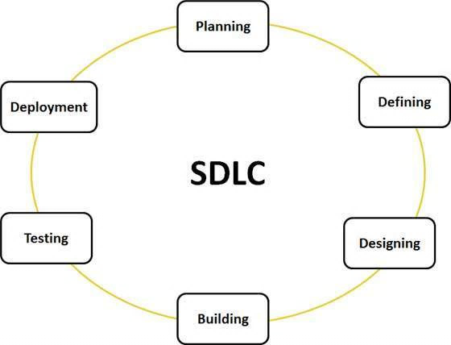
What is SDLC?
In software projects a systematic way of understanding problem, analyzing requirement, designing solution, developing product, testing product and deploying high quality software product is SDLC. Lifecyle of Software Project.

Slide 8
Types of SDLC
Linear
Waterfall
V Model
Incremental & Iterative
Delivery of End Product Value Can Wait
Spiral
RAD
Prototyping
Delivery of End Product Value Can't Wait
Agile

Slide 9
Why Various SDLC?
From one project to another project customer, user, businesses, organizations, technologies, team competencies, priorities are different. So SDLC depends upon…..
What is important? Responding to change, Quality, Cost, Scope
Team Capability: High to Low
Requirements: Stable to Extremely Agile
Technology: Stable to Extremely Complex or New
Number of Developers: Low to High
Criticality of output (quality): Low to Extreme

Slide 10
SDLC Depends upon
Small Team or large team
Greenfield Projects to enhancement project
Unknown technologies to widely known technologies
Simple technology to complex stack of technologies
Project is addressing change to Large organization or Small Organization
Project is addressing Local and small change or global and huge change
Revamp of legacy system to enable certain feature in legacy system
Documentation of legacy is extensively available or not available at all
Team is distributed or co-located

Slide 11
Which SDLC is the best?
Process<- -> People
Orientation
Agile Project Management
Low <- Certainty (Requirements/Technology) ->High
Traditional Project Management

Slide 12
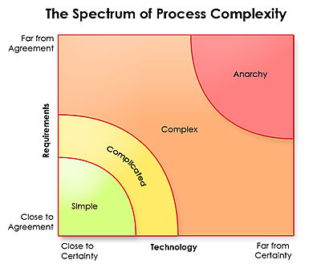
Which SDLC is the best?
Nothing works here
Ralph Stacey's complexity matrix
Waterfall

Slide 13
Discuss complexities of these Projects
Developing a static website of world history
Replacement of 30 years insurance software
Enhancing security, safety feature in Boeing Airplane
Improving performance of railway website
Improving security of Finance Ministry Intranet Portal
Developing a new online learning portal
Digital media campaign of a new movie to be released
Organizing and digitizing your 20+ years 100K photos (digital, hardcopy), songs (digital, cassettes), videos (digital, VCR format)
Developing BI system for a FMCG company
People are standing in long queue to transact at Bank. How to solve this problem?

Slide 14
Types of Systems
Act | Probe | Sense | Analyze | Categorize | Respond
 |  | a |  |  | a | Chaotic
a |  | a |  |  | a | Complex
 |  | a | a |  | a | Complicated
 |  | a |  | a | a | Simple
Chaos: Bus, Scooter, Cycle, Tram, Car, Pedestrian using the same road to commute is chaos. First you need to act to bring little order.
No practice helps here.
Complex: As a head of department you want to remove corruption from your department. First you need to probe problem and its reasons.
Practices keep emerging. No standard practices helps.
Complicated: One day your school going child is not interested in going school but you want him to go. First you need to sense the problem, its gravity.
Good practices learned from your elders and friends will help you here. Little tailoring may be required.
Simple: In your kitchen you need to make tea but you realized there is no water, milk, tea, sugar! First you need to sense the problem then categories reasons and solutions.
Best practices will help here. No change is required in practices..

Slide 15
Types of Systems
Agile
Order
Technical
Complexity
Structural Complexity
Disorder
Complicated
Sense
Analyse
Respond
Good Practices
Complex
Probe
Sense
Respond
Emergent Practices
Temporal
Complexity &
Directional
Complexity
Simple
Sense
Categorise
Respond
Best Practices
Novel
Act
Sense
Respond
Chaotic
Nothing works here
Waterfall
Chaos

Slide 16
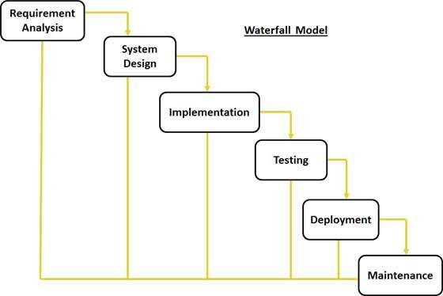
Waterfall

Slide 17
Video
S:\15-Video\B05-SDLC\Waterfall Process - Georgia Tech - Software Development Process

Slide 18
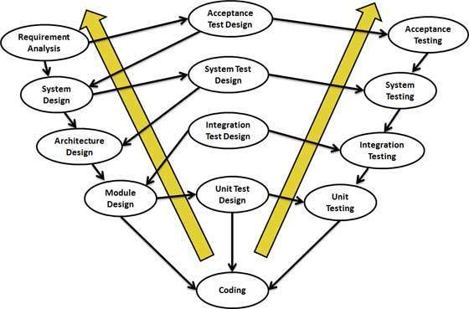
Verification and Validation model
Extension of the waterfall model and is based on association of a testing phase for each corresponding development stage

Slide 19
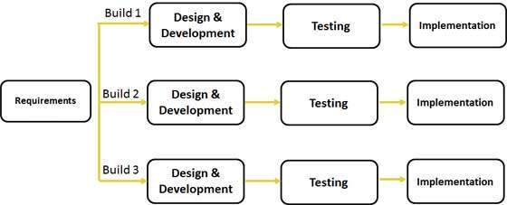
Iterative Model

Slide 20
Iterative Model
Requirements of the complete system are clearly defined and understood.
Major requirements must be defined; however, some functionalities or requested enhancements may evolve with time.
There is a time to the market constraint.
A new technology is being used and is being learnt by the development team while working on the project.
Resources with needed skill set are not available OR planned to be used on contract basis for specific period.
There are some high risk features and goals which may change in the future.

Slide 21
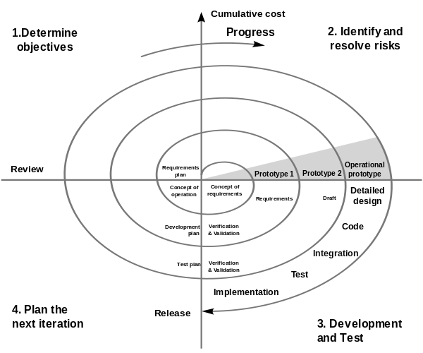
Spiral Model

Slide 22
4 Phases in Spiral
Identification
identification of system requirements,
subsystem requirements
unit requirements
Design
conceptual design = baseline spiral
architectural design,
logical design of modules,
physical product design
final design.
Construct & Built
POC = baseline spiral
working model of the software = build
Evaluation & Risk Analysis
Risk Analysis includes identifying, estimating, and monitoring technical feasibility and management risks, such as schedule slippage and cost overrun.
After testing the build, at the end of first iteration, the customer evaluates the software and provides feedback.
Overlap of these phases is possible

Slide 23
Video
S:\15-Video\B05-SDLC\Spiral Process - Georgia Tech - Software Development Process

Slide 24
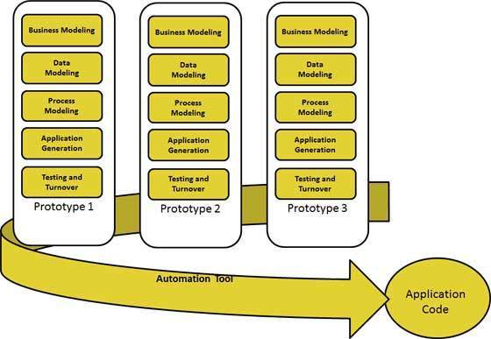
RAD (Rapid Application Development)

Slide 25
RAD
RAD should be used only when a system can be modularized to be delivered in incremental manner.
It should be used if there is high availability of designers for modelling.
It should be used only if the budget permits use of automated code generating tools.
RAD SDLC model should be chosen only if domain experts are available with relevant business knowledge.
Should be used where the requirements change during the course of the project and working prototypes are to be presented to customer in small iterations of 2-3 months.

Slide 26
Prototyping
Basic Requirement Identification: This step involves understanding the very basics product requirements especially in terms of user interface. The more intricate details of the internal design and external aspects like performance and security can be ignored at this stage.
Developing the initial Prototype: The initial Prototype is developed in this stage, where the very basic requirements are showcased and user interfaces are provided. These features may not exactly work in the same manner internally in the actual software developed and the workarounds are used to give the same look and feel to the customer in the prototype developed.
Review of the Prototype: The prototype developed is then presented to the customer and the other important stakeholders in the project. The feedback is collected in an organized manner and used for further enhancements in the product under development.
Revise and enhance the Prototype: The feedback and the review comments are discussed during this stage and some negotiations happen with the customer based on factors like , time and budget constraints and technical feasibility of actual implementation. The changes accepted are again incorporated in the new Prototype developed and the cycle repeats until customer expectations are met.
Notes:
https://www.tutorialspoint.com/sdlc/sdlc_quick_guide.htm

Slide 27
Agile
Requirements and solutions evolve through
The collaborative effort of self-organizing cross-functional teams
Adaptive planning,
Evolutionary development,
Early delivery, and
Continuous improvement,
Rapid and flexible response to change

Slide 28
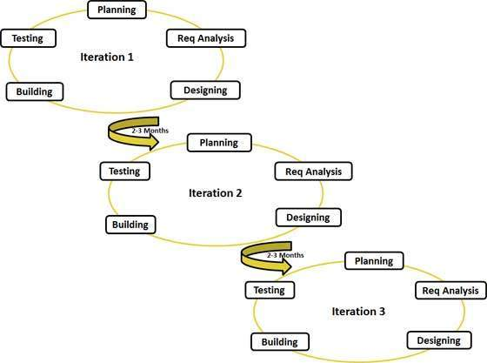
Agile Development
1-6 Weeks
1-6 Weeks

Slide 29
Agile Methods
Rational Unified Process (1994),
Scrum (1995)
Crystal Methods (2004)
Extreme Programming (1996),
Lean Software Development (LSD)
Feature Driven Development (1997)
Dynamic Systems Development Method (DSDM) (1995).
Kanban (2004)
Scrum-Ban (2009)
These are now collectively referred to as agile methodologies. Agile Manifesto was published in 2001.

Slide 30
Why Different Agile Methods
Some focus on the practices (XP, Agile Modeling)
Some focus on managing the flow of work (Scrum, Kanban)
Some support activities for requirements specification and development (FDD)
Some seek to cover the full development life cycle (DSDM, RUP)

Slide 31
Agile Project Management

Slide 32
Topics
Modern Project Management Challenges
How to address modern day PM challenges?
Challenges in Starting Agile Project Management
What is Agility?
Which Project Management Methodology is best?
Type of Systems
Complex Adaptive Systems (CAS)
Defined vs Empirical Processes
Values in Agile Manifesto
Agile Principles
Agile Methodologies
When Does Agile Methodologies Works Best?
Agile Project Lifecycle
Value Delivery & Project Life Cycle
Notes:
32

Slide 33
Modern Project Management Challenges
Uncounted uncertainties
Very tough to negotiate with stakeholders a change in baselined plan
Product value realization at the end of project lifecycle
Huge difference between expectations of end user, customer and sponsor
Typically development team is isolated from business scenario and it becomes very difficult to implement change request
Technology and project environment changes during project execution
Customer does not want to hear about new timelines even after requirement changes. Because project is baselined!
Customer end up paying more because critical dates missed, non-usable product features, less-value product
Not enough decentralized power stations to make decisions during project execution
Execution team and project management teams are different. Execution team does not have power and execution does not happen as per initial plan
Work product delivered at the end of every phase is not usable work product. Typical it is some paper prototype, document or some other thing.
Notes:
33

Slide 34
How to address modern day PM challenges?
Involve end user
Engage relevant stakeholders
Produce in increment
Deliver high value feature first
Take frequent feedback and allow customer to change original requirements
Allow customer to prioritize
Get commitment from team for valuable product not of activities
Employ the power of level of planning
Involve team in risk identification and responding to risk
Transparency in project management
Continuous improvement
Learn quickly
Notes:
34

Slide 35
Challenges in Starting Agile Project Management
Team
Getting experienced team member
Getting 100% committed team
Getting collocated team in early agile adoption
Team’s mindset shifting from action to delivery
A cross disciplined team with generic skills
Environment
Trust building
Open communication with customer
Keeping politics out
Infrastructure & Support
Active risk management framework
Robust, flexible and adaptable configuration and data management systems
You need a variety of communication, collaboration, management and development tools. Therefore a culture is required to support and facilitate this endeavors.
Management need a framework from where they get to know what is happening in the project.
Upfront training
Supporting in early period when velocity is less

Slide 36
Video
S:\15-Video\B05-SDLC\What is Agile

Slide 37
What is Agility?
Agility is about quickly responding to changes
Learning quickly from mistakes and incorporate lessons learned
Being proactive
It helps in all aspects of success- Personal, Technical and Organizational
Notes:
37

Slide 38
What is Agility?
How agility is possible with complex, bureaucratic, gigantic processes.
Traditional processes are reactive in nature, they learn very late, respond very slow
Notes:
38

Slide 39
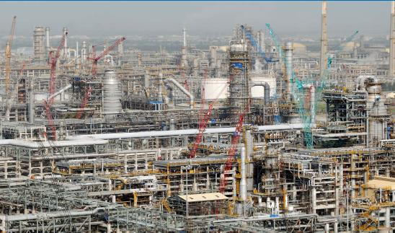
What is Agility?
This refinery along with township in Jamnagar, Gujarat, India was completed in 1999 in 36 months.
There was the time when over 100,000 people working on the project on any particular day and sponsor was paying rental for a crane Rs 10 million every day.

Slide 40
Complex Adaptive Systems
Think about how newly born child is going to learn about talking, walking, learning, eating etc.
What process you use to climb mountain?
In the last couple of decades scientists and managers have articulated a profound shift in their view about how organisms and organizations evolve, respond to change, and manage their growth.
Complex Adaptive Systems theory is one of the root threads of agile development. The concepts about how biological systems evolve and adapt have relevance, if only metaphorically, to organizations and how they evolve and adapt.
Creativity and innovation are the emergent results of well-functioning agile teams.
In complex system things get done because people adapt not because they blindly follow
Former Visa International CEO Dee Hock coined the word “chaordic” to describe both the world where Order exists in Chaos.

Slide 41
Defined vs Empirical Processes
Defined Processes
Assumes that every piece of work is completely understood
Input is well-defined
A set of well-defined input produces same output every time within known variance limit
Has tightly coupled steps
No checkpoint and feedback steps

Slide 42
Defined vs Empirical Processes
Empirical Processes
Relies on frequent inspections and adaption
Applies to those process which are loosely defined because of their complexity
Understand that output of a process can be unpredictable and unrepeatable

Slide 43
Value in Agile Manifesto
“We are uncovering better ways of developing software by doing it and helping others do it. Through this work we have come to value”
Individuals and interactions over processes and tools
Working software over comprehensive documentation
Customer collaboration over contract negotiation
Responding to change over following a plan
That is, while there is value in the items on the right, we value the items on the left more.
www.agilemanifesto.org

Slide 44
Agile Principles
Satisfy customer by continuous delivery of valuable product
Welcome Change even at late stage
Deliver working software Frequently
Business and Developer work together
Build around Motivated Individuals- Give team opportunity, trust them
Face-to-face communication
Working software is the primary measure of progress.
Sustainable Development
Continuous Technical Excellence
Simplicity--the art of maximizing the amount of work not done--is essential.
Self Organizing Team
Team reflection at regular intervals
www.agilemanifesto.org

Slide 45
Videos
S:\15-Video\B04-Agile-Simulation
Agile Roles
Agile Simulation - Part 1 _ Meet the Agile Team
Lifecycle
Agile Simulation - Part 2 _ Agile Lifecycle Overview
How to Ground Rule
Agile Simulation - Part 3 _ Purpose, Agenda, Team Norms
Collaboration
Agile Simulation - Part 18 _ Collaboration During the Iteration

Slide 46
Agile Characteristics
Adaptability not Predictability
Accepting that outcomes are not predictable and process are not repeatable
Values and Principles of Collaboration
The conventions which we agree we define those
Processes are in manuals; practices are in field.

Slide 47
Agile Methodologies
Scrum
Extreme Programming (XP)
Lean Software Development (LSD)
Feature Driven Development (FDD)
Dynamic System Development Methods (DSDM)
Kanban
Scrum-Ban
Crystal Methods

Slide 48
Scrum
We will discuss tomorrow in detail

Slide 49
Agile Methodologies-XP
Originally devised by Kent Beck as an agile method focused on engineering practices. Typical iteration length varies between 1-3 weeks.
XP Values
Communication
Simplicity
Feedback
Respect
Courage

Slide 50
Agile Methodologies- XP
XP Practices
Fine scale feedback
Test Driven Development via Programmer Tests and Customer Tests (Unit Tests & Acceptance Tests)
Planning Game
Whole Team (including on-site customer)
Pair Programming (2 people sitting on one work station, one writing test case on notes and another writing code)
Continuous process rather than batch
Continuous Integration
Design Improvement / Refactoring
Small Releases

Slide 51
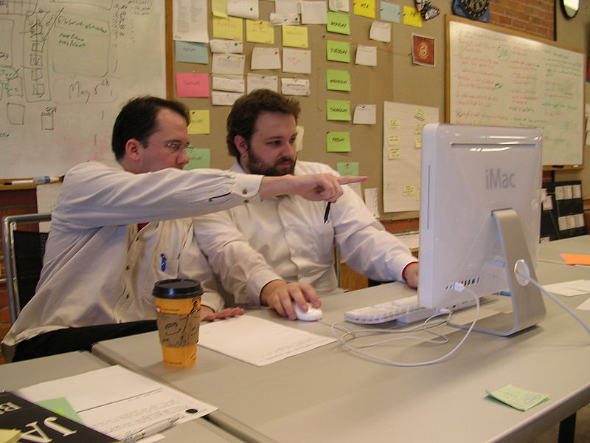
Pair Programming

Slide 52
Agile Methodologies- XP
XP Practices
Shared understanding
Simple Design (Do Simple Things, You Aren’t Gonna Need It (YAGNI), Once And Only Once (DRY), Simplify Vigorously)
System Metaphor
Collective Code Ownership
Coding Standard or Coding Conventions
Programmer welfare
Sustainable Pace

Slide 53
Video
S:\15-Video\B05-SDLC\
Extreme Programming (XP) - Georgia Tech - Software Development Process
Extreme Programming

Slide 54
Agile Methodologies- LSD
Much of its principles and practices are from Lean Enterprise Movement and companies like Toyota
Lean Software Development (LSD) 7-Principles
Eliminate Waste (Just in Time –JIT, Kanban)
Amplify Learning
Decide as late as possible (Make a decision when not making it means leaving some important option)
Deliver as fast as possible
Empower the team
Build Integrity In (overall experience of system quality, product quality should be dependable)
See the whole (see big picture)

Slide 55
Agile Methodologies- FDD
FDD is a model-driven, short-iteration method
First step is to establish an overall model shape
Followed by 2 week “design by feature, build by feature” iterations.

Slide 56
Agile Methodologies- FDD
Eight practices of FDD
Domain Object Modeling
Develop by Feature
Component/class ownership
Feature Teams
Inspections
Configuration Management
Regular Builds
Visibility of Progress and Results

Slide 57
Agile Methodologies- DSDM
Earlier in 1994 it was known as RAD method
Previous version of DSDM is 4.2, that was released in 2003. Latest version of DSDM released in 2007 is also called DSDM Atern
DSDM Atern used MoSCoW principle to prioritize requirements
It is compatible with ISO9000 and PRINCE2
“Fitness for business purpose” is primary criteria for delivery and acceptance of system
It focuses that 80% of the system can be developed in 20% of the time

Slide 58
Agile Methodologies- DSDM
8 Principles of DSDM
Focus on the business need
Deliver on time
Collaborate
Never compromise quality
Build incrementally from firm foundations
Develop iteratively
Communicate continuously and clearly
Demonstrate control

Slide 59
Agile Methodologies- Kanban
In Japanese Kanban means Sign-Board
Kanban was developed by Taiichi Ohno, at Toyota, to find a system to improve and maintain a high level of production.
Kanban is scheduling system for Lean and JIT production.
Kanban is one method through which JIT is achieved.
Kanban is pull based planning and execution method. Work is not planned and pushed into work queue of team. Team signals when they are ready to take more work and pulls into their queue. Uses cards to signal the need of items
Under Kanban or Lean approach queues or inventory of work in any state is seen as waste.
WIP limits: helps team in optimal flow of work items, minimizing any associated waste
Allow team to achieve process optimization while respecting and maintaining sustainable pace.

Slide 60
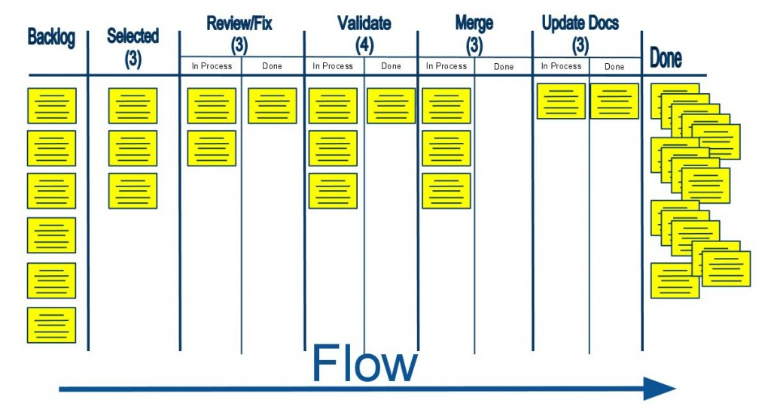
Kanban Board
Introduction / Agile Project Management

Slide 61
Video: Kanban
S:\15-Video\B02-Agile-PM\Intro to Kanban in Under 5 Minutes (What is Kanban, Learn Kanban)

Slide 62
Agile Methodologies- Scrum-ban
Scrum-ban is a software production model based on Scrum and Kanban
Scrum-ban is especially suited for maintenance projects or (system) projects with frequent and unexpected user stories or programming errors. Thus time-limited sprints of the Scrum model are of no appreciable use.
Scrum's daily meetings and other practices are highly useful
Visualization of the work stages⁽¹⁾ and limitations for simultaneous unfinished user stories⁽²⁾ and defects⁽³⁾ are part of the Kanban model.
The team's workflow is directed in a way that allows for minimum completion time for each user story or programming error, and on the other hand ensures each team member is constantly engaged.

Slide 63
Agile Methodologies- Crystal
Crystal is one of the most light-weighted software development methodology
Crystal is a family of methodology. Family members are Crystal Clear, Crystal Yellow, Crystal Orange etc.
Which type of crystal methodology should be used for a particular project depends upon criticality of the project and number of people involved
This methodology relies on the fact the processes can be tailored based on unique characteristics of the project

Slide 64
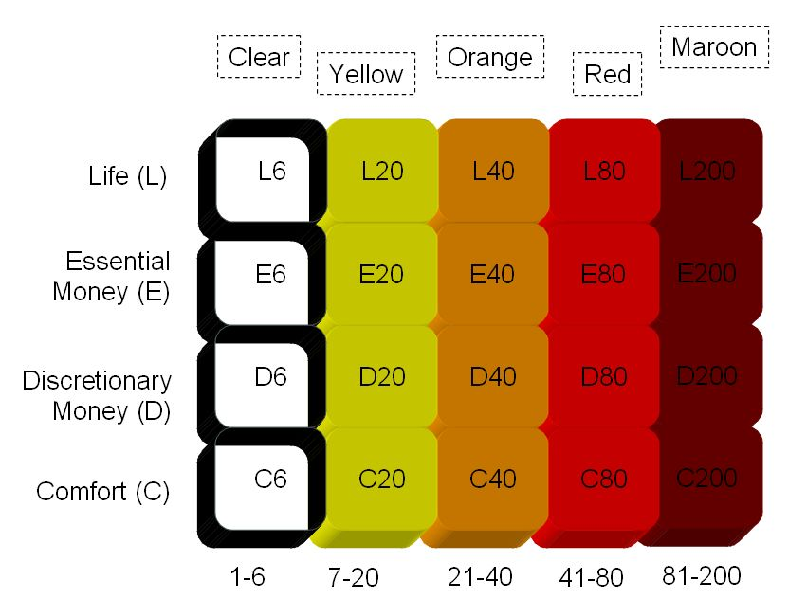
Agile Methodologies- Crystal
Criticality, Defect cause ...
No of People Involved

Slide 65
When does Agile Methodologies Works Best?
When problems you are solving have following characteristics
Going to change while solving
Speed of development cannot be determined
Turbulence in environment
Customer doesn’t know how exactly it will look like

Slide 66
Agile Project Phases
At high level
Envision : Determine the product vision, project scope, project community, how the team will work together
Speculate: Develop feature-based release, milestone, and iteration plan to deliver on the vision
Explore :
Deliver tested features in short timeframe, constantly seeking to reduce the risk of the project
Adapt :
Review the delivered results, the current situation, team’s performance and adapt as necessary
Close :
Conclude the project, pass along key learning and celebrate

Slide 67
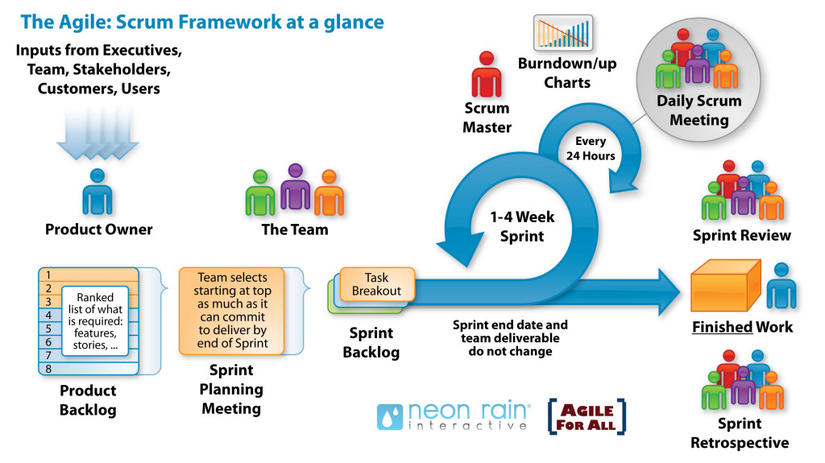
Agile Project Life-cycle
Product Vision
Product Backlog
Project Kickoff
Release Planning

Slide 68
Value Delivery & Project Life Cycle
Phase1
Phase2
Phase3
Phase4
Phase5
Define
Design
Develop
Test
Deploy
$
Waterfall
Define
Design
Develop
Test
Deploy
Iteration-1
$
Agile
Define
Design
Develop
Test
Deploy
Iteration-2
$
Define
Design
Develop
Test
Deploy
Iteration-3
$
Iterative
Define
Design
Develop
Define
Define
Define
Design
Design
Design
Develop
Develop
Develop
Test
Test
Test
Test
Deploy
Deploy
Deploy
Deploy
Iteration
Iteration1
Iteration2
Iteration3

Slide 69
Agile Mindset

Slide 70
Topics
Agile Core Practices
Best Practices of Agile modeling
Iteration
Incremental Delivery
Travel Light
Agile Product Building
Agile Documentation
Agile Architecture
Agile Testing
Last Responsible Moment
Refactoring
Technical Debt
Mindfulness
Energized Team
Poka Yoka
Agile Roles
Agile Health Checkup

Slide 71
Agile Core Practices
Active Stakeholder Participation
Apply the Right Artifacts
Collective Ownership
Create Several Models in Parallel
Create Simple Content
Depict Models Simply
Display Models Publicly
Iterate to Another Artifact
Model in Small Increments
Model with Others
Prove it with Code
Single Source Information
User the Simplest Tools

Slide 72
Best Practices of Agile modeling
Just barely good enough (JBGE) documentation. Application of the KISS principle.
Document continuously.
Document ALAP (as late as possible).
Architecture envisioning.
Lookahead modeling is used to reduce overall risk.
Multiple models can be used.
Active stakeholder participation.
Requirements envisioning.
Prioritized requirements.
Iteration modeling.
Test-driven development (TDD). JIT Approach.
Model storming. JIT Approach.
Executable specifications (not static documents).
Single-source information.
Notes:
Just barely good enough (JBGE) artifacts. A model or document needs to be sufficient for the situation at hand and no more. This is an application of the KISS principle.
Architecture envisioning. At the beginning of an agile project, high-level architectural modeling is done to identify a viable technical strategy.
Lookahead modeling is used to reduce overall risk.
Multiple models can be used. Each type of model has its strengths and weaknesses. Effective developers have a range of models in their intellectual toolkit enabling them to apply the right model in the most appropriate manner for the situation at hand.
Active stakeholder participation. Stakeholders are important for funding the process and accepting the results, that is why they are involved as soon as possible. Stakeholders provide information in a timely manner, make decisions in a timely manner, and are as actively involved in the development process as possible.
Requirements envisioning. At the beginning of an agile project, time is invested to identify the scope of the project and to create the initial prioritized stack of requirements.
Prioritized requirements. Requirements are implemented in priority order, as defined by their stakeholders, so as to provide the greatest return on investment possible. Collecting the low hanging fruit.
Iteration modeling. At the beginning of each iteration, a bit of modeling is done as part of the iteration planning activities.
Test-driven development (TDD). Requirements are written like a test. Tests are performed and then just enough code is made to fulfill that test. TDD is a JIT approach to detailed requirements specification and a confirmatory approach to testing.
Model storming. Throughout an iteration a brainstorming session can be held, called "model storm" on a just-in-time (JIT) basis for a few minutes to explore the details behind a requirement or to think through a design issue.

Slide 73
Iteration / Sprint
Agile project management relies on planning, developing and delivering product features in iterations
Iteration or sprint are time-boxed and duration can not changed from one iteration to another
Iteration is fixed time period in which team need to deliver some valuable product to customer
Prescription for duration length varies from one method to another in agile. In XP iteration length varies 1-3 week (typically one week), scrum and other methods it varies between 2-4 weeks (typically 4 weeks)
Iteration is also known as Sprint in Scrum Methodology

Slide 74
Incremental Delivery
Delivering the complete product of a project in iterations. It helps in
Learning from previous iteration
Delivering high business value earlier
Adapt to change
Delivering more business value
Removing the waste by not doing those things which are not needed

Slide 75
Travel Light
You need far less than what you think. Therefore carry on only those things which are most important and urgent.
YAGNI (You aren’t gonna need it)
TAGRI (They aren't gonna Read It)
This is different type of mountaineering. You may need to come back, you may need to change your path, trust that you will get stuff you need on the way etc factor exists here.

Slide 76
Agile Product Building
Build complete product, all the time
One button should produce needed documentation, build the product executables, create installation materials, produce test results and tested components
Build should also work from command line
Everyone in team should use the same build process

Slide 77
Agile Documentation
Maximize stakeholder investment. Produce document only when
It is needed by a stakeholder
Needed to define contract model
You need to think something in many iterations involving multiple groups
It is needed for external communication
Document only those things which are least likely to change
First identify the specific customer of the document
The document facilitates in estimating
Sufficiently index, details, accurate and consistent

Slide 78
Agile Documentation
Strategies for reducing documentation CRUFT
C- How correct is document?
R- Will document be read?
U- Will document be understood?
F- Will document be followed?
T- Will document be trusted?

Slide 79
Agile Architecture
Do the simplest thing possible which makes future changes/additions easier
No up-front high-level system architecture
No up-front high-level component architecture
No up-front high-level data model
Determine the details of technology when building functionality

Slide 80
Agile Testing
All code must have test cases, ideally they should be created earlier
Unit tests should be executed during automated build
A build should be performed many times a time, ideally whenever anything is checked-in or committed to configuration server
If anybody’s code causing crash he should be informed immediately and that person should fix that problem first
All unit test must pass before code can be released

Slide 81
Last Responsible Moments
Delay the decisions till the moment you have option to exercise because after this point one important options may be eliminated
It helps you in delivering more value in less time by doing only those things which are of high priority
It reduces inventory carrying cost
Getting more information and making more informed decision at last moment

Slide 82
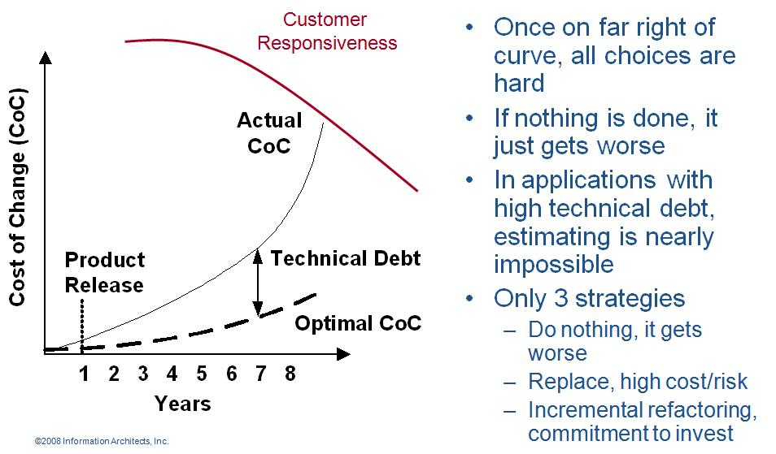
Refactoring
Agile programmer writes simple and bare minimum code they do not complicate the code
Down the line structure the code without changing its behavior. It helps in improving the quality (maintainability, readability) of code

Slide 83
Technical Debt
While writing code agile programmer do not pay attention to structure, duplication etc but to functionality and make sure that code is passing all unit test cases
In this process if they do not clean the code by structuring (refactoring) it will become unreadable and un-maintainable and over a period of time this cause increases response time to fix the problems, adding new feature and deteriorate the quality.
The concept of unclean code is called technical debt. Technical debt keep increasing over the period of time therefore Agile team need to pay this debt back by putting efforts in refactoring.

Slide 84
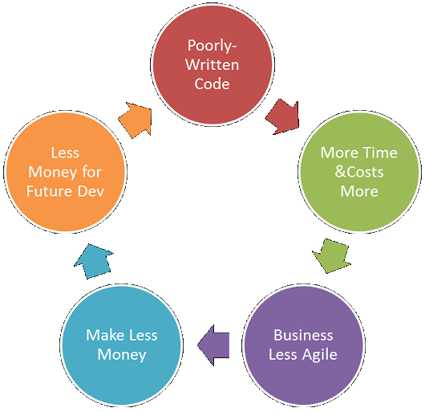
Technical Debt
Vicious Cycle of Technical Debt

Slide 85
Mindfulness
Agile team need to be conscious all the time, they need to keep observing patterns and proactively resolving the issues at root.
For example if they know that now it is taking more time to add even simple thing in existing code then it means time has come and they need to pay technical debt by refactoring

Slide 86
Energized Work
Love your work: When you feel that I enjoy programming. I enjoy solving problems, writing good code, watching tests pass, and especially removing code while refactoring. I love to program in my spare time and sometimes even think about work in the shower. You love your work
Do not work overtime, enjoy balanced life, remain healthy, energetic and excited about work
When at work completely cut off from interruption like phone, email, IM etc. Pay 100% attention to work at hand
If you are making more mistake than progress then that is the time for break.

Slide 87
Poka Yoka
Mistake (Error) Proofing
Don't Accept a Defect
Don't Make a Defect
Don't Pass on a Defect
From Supplier
You
To Customer
Ideally, design the product so that it can't be assembled incorrectly
Error is deviation from process. Defect is in product who is deviating from specification or don’t meet customer expectations. Defect are introduced by errors

Slide 88
Agile Roles
Pigs vs Chickens
Pigs are those roles which are committed
Chickens are those roles which are involved
Product Owner
Grooms product backlog, interface between product user and team
Prioritizes requirements based on value
Has authority to change requirement, reject product
Justify the importance of product and its features
Scrum Master
Process owner, ensures that stakeholders follow the processes
Removes impediments
Works as a servant leader
The Team
Includes architect, developer, tester, UI Desiger
Cross functional multi skilled team
Responsible for quality of the product

Slide 89
Agile Roles
Agile Tester
Try to identify if a user does not do what he is suppose to do then what happens to the software? Report it.
Helps customer, product owner in writing acceptance test cases
Coach: Identify and Improve work habits
Interaction Designer: Learns and decides how users will interact with system.
SME (Domain Expert): Understands the business domain, regulatory requirements and defines business rule for the product

Slide 90
Agile Health Checkup
To know the agile maturity in your project you can perform following Agile Health Checkup. Discuss in group and ask team to rate these parameters on the scale of 1-5
Frequent Delivery
Reflective Improvement
Close Communication (does it take less than 1 min to get you question answered by a person who know the answer?)
Focus (everybody understand the goal and desired outcome of the delivered software?)
Personal Safety (can you give bad news to your boss?)
Easy Access to Outside Experts
Strong Technical Environment (SVN used? Test Automation?)
Sunny Day Visibility (Does everyone on the team understand the rate of progress being made on the product?)
Regular Cadence or Rhythm (Is heartbeat of the system on?)

Slide 91
Communication

Slide 92
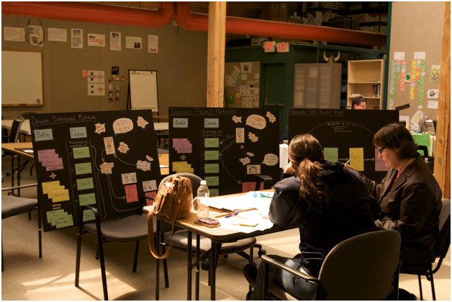
Team Space
Team space is working area of agile project team. Only those people who are contributing to project directly should be allowed to sit, stay and talk in that area
This area should be
Informative
Spacious
Comfortable to work
Shielded from external noise
Easy to collaborate
Having expert in the same room where rest of the team is sitting is called “Expert in earshot”

Slide 93
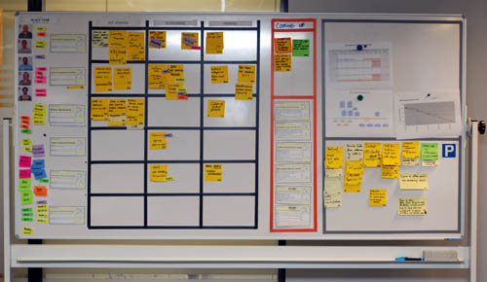
Information Radiator
Team Members
Work Progress
Impediments
Work Progress
Work Completed
Parking Lot

Slide 94
Osmotic Communication
Agile project relies on collocation, minimum documentation, least reporting, maximum constructive engagement. This can be achieved if frequently sought important information is available in published form in team space
Whoever need the information can go and get the information without wasting time in requesting, making, sending, receiving the information
Benefits
Least cost, effort and time waste in communication
Updated information is always available without making new reports
People can get whatever particular information they are looking for
Happens at the same time
Feedback loop is quick
Those people who are left in regular reporting also get benefitted
No junk, old, repetitive information, but fresh and useful.
Dis-benefits
Some people get extra information which they do not need
It is left to individual’s interpretation

Slide 95
Daily Stand-ups
Daily stand-up is heart beat of agile project management
Team meets daily (typically in working area, war room) at fixed time (time should not be changed) preferable first thing in morning
This is not reporting session but information sharing among team members
Only “Pigs” allowed to speak, “chicken” should listen (they are not allowed to interfere or ask while stand up meeting is in progress)
It is 15-20 min meeting, conducted while everybody is standing (showing the sense of urgency). A person should not take more than 2 min to update this work status.
Any one in the team can facilitate this meeting
Project manager notes the impediments and start working on those immediately after the meeting is over.

Slide 96
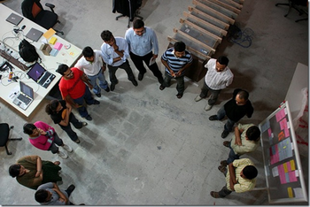
Daily Stand-ups
Tools & Techniques / Communication
3 Questions of standup meeting which every team member must address are
What did they do yesterday?
What are they planning to do today?
Any impediments on the way today?

Slide 97
Level of Listening
Level 1: Internal Listening (interpret in own language)
Level 2: Focused Listening (Responding without interpreting in own language)
Level 3: Focused but understand global environment (team, organization, customer etc)

Slide 98
Communication Skills
Active Listening
Probing Ideas for Better Understanding
Fact Finding
Expectation Management
Conflict Resolution
Next Step Identification
Making Commitment
Contribute Effectively

Slide 99
Communication Barriers
Physical Distance => Physical Proximity
Working in Different Shifts => Temporal Proximity
Human Language
Technical Knowledge
Detrimental Attitude
Difference in Culture
Difference in Project Environment
Attitude, willingness => Amicability
Communication Channels

Slide 100
Communication Methods
Push Communication
Pull Communication
Interactive Communication

Slide 101
Tools & Techniques Agile Analysis & Design
Notes:
101

Slide 102
User Story
A user story concept is kernel of Agile Project Management
A user story is work which a user want system to accomplish because it meets some of his objectives.
A user story is not functional specification document. It is a promise of product owner to the team that he will explain the requirements in details when the team is working on this
User story template
“As a user I want to accomplish something so that business value”
“There have been great societies that did not use the wheel, but there have been no societies that did not tell stories.” Unknown

Slide 103
Types of User Stories
Business user story
“As a class teacher I want to mark attendance of student so that we can issue them certificate”
Bug user story
“An error message is displayed whenever I try to save file in pdf format”
Technical user / Technical Spikes story
“Research a search component in .NET3.5 which is fit for our application”
Non-functional user story
“The Student Affairs Information System is up and running 99.9% during the registration time period defined in the Academic Calendar.”
Documentation user story
“Develop a user manual for teachers to use teacher module”

Slide 104
3Cs of User Story
Card
Conversation
Confirmation

Slide 105
INVEST Model of User Story
INVEST model defines following characteristics of a user story
Independent
Negotiable
Verifiable
Estimatable
Sized Appropriately
Testable

Slide 106
Epic, Feature, Story, Task
Epic is a collection of features. An epic is typically 1-3 months in duration
Feature is collection of stories. A feature is typically 2-4 weeks in duration
User-story is smallest unit of requirement created from features. A user-story is typically less than a week in duration
Task are smallest unit of executable items which team members assign to themselves to complete a user story. A task is typically of 8 hours in duration

Slide 107
Product Roadmap
A product roadmap is a plan where the features are planned for release on a timescale
It talks about business value addition to the customer by each release
Date, features and objective of each release
Overall product features (product backlog and business story)
Technical backlog (non-functional requirements, technical story)
Notes:
107

Slide 108
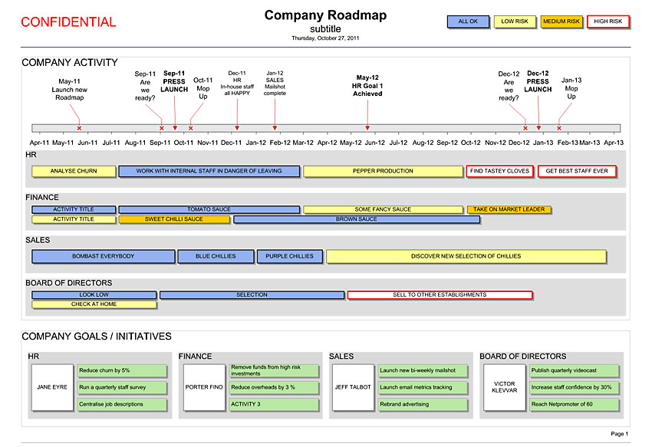
Product Roadmap

Slide 109
Story-maps
The main purpose of story mapping is to understand the end-to-end user requirements and stitch them in a logical thread so that users get maximum return on the business value
Benefits of Story-maps
Overall workflow of the system help in understanding value chain.
Relationship between large stories and child stories get established
Completeness of backlog can be validated
A basis of prioritization
Helps in release planning
Notes:
109

Slide 110
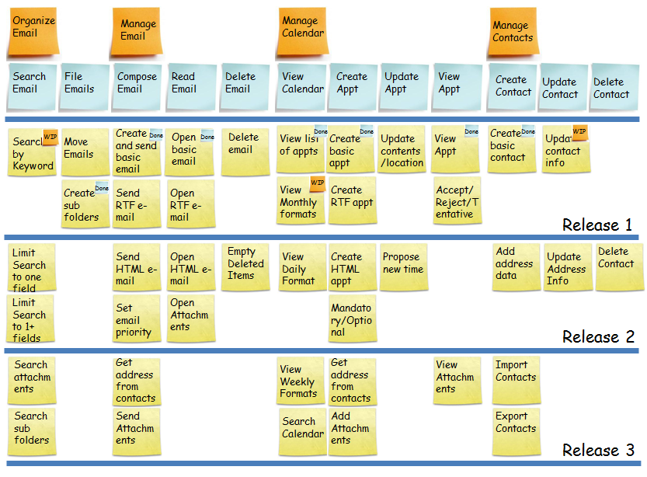
Storymaps
Notes:
110

Slide 111
Agile Estimations
Notes:
111

Slide 112
Videos: Agile Estimation
S:\15-Video\B01-For-Agile-Class\Agile Estimation.mp4

Slide 113
Relative Sizing
We know at the start of project not enough detail is available to estimate the size of work. But high level requirements are available in the form of epic or module
Best way to estimate in this situation is relative sizing method
Based on current understanding of system and modules team picks up smallest size epic and then start comparing that with other modules.
Down the line at the time of release planning features or user stories are identified in epic and finer estimation is possible but again at this level preferred method of estimation is Relative Sizing
Hours, duration, cost based quantitative estimation makes sense only when you know the task to be done. But even for user story level estimation in release planning neither you have time not it is worth to identify task to do quantitative estimation
Notes:
113

Slide 114
Story Points
User story is the functionality of the system which has value in the eyes of customer
Count of user stories is called story points this is used to size user stories.
Because all stories are not same in efforts, complexity and risk therefore different methods are used to normalize this factor
Size is function of relative efforts, complexity and risk not of duration or IEH etc. Therefore when estimating size take away duration, number of people etc from your mind.
Some story point estimation methods are
T-shirt size – Story Point Estimation
Fibonacci Series – Story Point Estimation
Fruit size – Story Point Estimation
Notes:
114

Slide 115
Story Points
Let us say our product back log has
8 x bananas (5 points each) = 40 story points
10 x pineapple (20 points each) = 200 story points
6 x oranges (8 points each) = 48 story points
30 x bunches of grapes (2 points each) = 60 story points
Total story points in product backlog is 40+200+48+60 = 348
Les us assume that based on guess or some previous release teams knows that their velocity is 30 story points
Total iterations required = 348 / 30 = 11 iterations
If iteration is of 2 weeks then 22 weeks required to finish the work in product backlog

Slide 116
Wideband Delphi
Wideband Delphi is consensus based estimation method. A moderator facilitates the session.
Delphi technique keep names anonymous and helps avoiding biases and politics
Moderator reads and explains every feature to be estimated
All experts provides the estimates with basis of estimates. Estimates are provided anonymously
After first round of estimation is complete each items is discussed in group with all experts along with basis of estimates
In second round of discussion experts provides feedback after listening all basis of estimates and update these estimates
Notes:
116

Slide 117
Planning Poker
Planning poker is widely used estimation technique in agile projects. This is a variation of Wideband Delphi.
Logistic Required for Planning Poker Estimation
As many set of deck cards as many estimators in the room
All the team members with a deck of cards inside the room
A coordinator with laptop
A facilitator
Product owner
Planner Poker Process
Facilitator projects the product backlog on wall using a projector
He reads loudly a user story at a time so that everybody in the room understand what they need to estimate
Estimator estimates it silently and shows the card only to the coordinator
Coordinator documents all the estimates provided by all estimator
If there is difference between estimates then estimators who provided two extreme estimates need to talk the basis of estimates.
After a short discussion. Next round of estimation starts the same way as before and coordinator document the estimate provided by estimator
Keep repeating steps 3,4,5,6 till estimates provided by estimators are not converged
Read next user story
Notes:
117

Slide 118
Affinity Estimation
If product backlog has more than 20 items then implementing planning poker method of estimation is too much time consuming. In that case affinity estimation technique is most suitable
This helps in providing coarse estimates and good enough for release planning but for iteration planning you should use Planning Poker.
Logistics for Affinity Estimation
As may set of cards with printed user story. A story on a card.
A wide magnetic board with magnetic balls
All the team members inside the room
A coordinator with laptop
A facilitator
Product owner
Notes:
118

Slide 119
Affinity Estimation
Facilitator writes “smallest” at extreme left end of magnetic board and “largest” at extreme right of magnetic board
Set the ground rule of estimation session. Like it is mute session so we should not talk at all. All cards which are put on table need to be arranged on wall from left to right in terms of their relative size. You can shift position of cards from left to right or vice versa put by other member but without talking, convincing anybody, arguing or any kind of body language.
Estimators starts reading card and arranging them on the wall. If required they can discuss in private with product owner
If they are not able to understand any card ever after discussion with product owner they can move the card into Questionable column
After the session is over they need to group these cards in 5 or more groups like smallest, minor, medium, larger, largest
Coordinator need to type all these estimates into computer and share with project manager

Slide 120
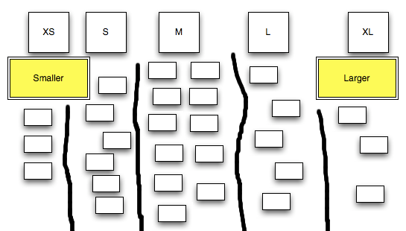
Affinity Estimation

Slide 121
Planning, Monitoring & Adapting
Notes:
121

Slide 122
Videos: Agile Planning
S:\15-Video\B01-For-Agile-Class\Agile Planning.mp4

Slide 123
Adaptive Planning
Adaptive planning is about incorporating lessons learned. Adjusting your future pace, processes, resources etc based on previous cycle of delivery.
Adaptive planning is required because what we want to develop may not be completely known or other factors like processes, tools, technologies, skills availability, business environment, market condition etc are not fully known or reliable and they all affect your planning.
It is complete opposite of predictive planning where everything is known at the time of planning.
In modern time it is extremely difficult to know about all the factors, which are affecting project success, in advance
Adaptive planning and empirical processes are the truth of 21st century! Days of definitive processes and predictive planning are not many.

Slide 124
Agile Planning
Agile project management does not rely on big bang planning rather it believes in level of planning.
Planning starts after product backlog grooming
Three level of planning in agile are
Release Planning
Iteration Planning
Daily Planning

Slide 125
Product Backlog Grooming
If product backlog is not setup then first thing after kickoff is create product backlog
Put all the user story PO and team can visualize in the product backlog
If user story is vague or large then break the user story into smaller, manageable units
Spent 5-10% of the time in every sprint in grooming the product backlog

Slide 126
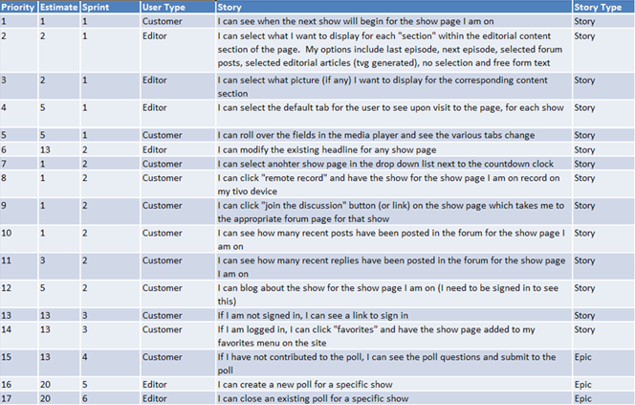
Backlog
Product Backlog
Product backlog grooming is continuous activity. PO is responsible for this.

Slide 127
Agile Planning
Release Planning
Creating a release plan is responsibility of product owner
If some user story cannot be estimated due to technical complexity then technical spikes are created
Typical length of a release varies between 3-6 months. For every month of work you can spend max one day for release planning. Thus 3 month release you can spend max 3 days.
Release planning should not be done without knowing velocity
It takes 3-4 uninterrupted iterations to benchmark velocity for a project team
Release planning depends upon
Deadline from competitor
Supporting the contract
To meet predetermined schedule
Supporting financial deadline
When there is enough value
To test the product
Two types of release plan
Scope-boxed release plan
Time-boxed release plan

Slide 128



Agile Planning
Release Planning
Product owner is ready with prioritized product backlog (prioritization is done based on business value)
Product owner defined release goals
During release planning product owner picks up only those user stories and features which helps him achieving release goals
All the selected user stories are pushed into release backlog
User stories in release backlog are size estimated using agile estimation techniques like story points
User stories in release backlog are again prioritized. It helps in creating number of iterations and iteration plan.

Slide 129
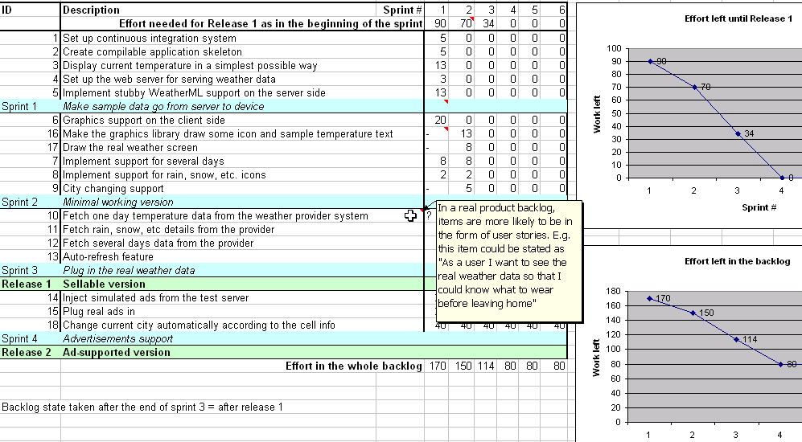
Backlog
Release Backlog
Release backlog is created during release planning meetings. PO is responsible for this

Slide 130
Agile Planning
Iteration/Sprint Planning
In iteration planning team identifies the task to be performed for each user story.
Task are pushed into iteration backlog
Iteration planning is held after retrospective meetings of last iteration
Typical iteration length varies from 1-4 weeks.
Iteration planning duration (1 hour for every week of iteration)
Iteration planning identifies iteration backlog items, assumptions, risks, actions, dependencies
Some team start counting iteration from zero so the initial iteration is called Sprint 0 or Iteration 0. In this iteration they take all technical spike which will help them in estimating size of complex user stories. Preparing initial architecture, solving infrastructure setup and configuration issues. Following Sprint 0 they start release planning
Tasks in iteration backlog are not assigned to any team member. Agile teams are self-organized and they pickup the task on their base.
Number of hours available in any iteration are calculated as Ideal engineering hours.

Slide 131
Agile Planning
Iteration Planning
Product owner defines Iteration Goal
User stories to be completed in an iteration is prioritized and selected by product owner. Agile team helps him in prioritizing technically related user stories.
Team picks selected user story and identifies task to be done in order to complete selected user story. All the identified tasked are pushed into Iteration Backlog. Mostly these will be programmer-centric tasks. Consider definition of “done”.
Effort estimate of each task is completed by team member using their experience
During planning team stop pushing tasks into iteration backlog when number of hours available for the iteration are exhausted

Slide 132
Backlog
Sprint Backlog
Unlike product backlog and release backlog which is comprised by user stories, sprint backlog is comprised of task
Sprint Backlog can have following types of tasks
Design Tasks
Coding Tasks
Testing Task
Documentation Tasks
No one is allowed to add user story or task in Sprint backlog but team can delete task if they feel out of time
Sprint backlog is developed at the time of sprint planning

Slide 133
Backlog
Sprint Backlog
Generally every task in sprint backlog should be related to some user story
To identify task for user story programmers need to do the detail discussion about user story with PO
Each task in sprint back log should have following information in the form of Task card
Task description
Estimated hours
Owner name (if taken by any team member)
Exit criteria
Verification method (test or inspection)
Who will perform verification

Slide 134
Agile Planning
Daily Planning
Immediately after or before daily standup meeting sessions and the team updates the kanban board.
This reflects the progress and planning of the day based on
The work progress of previous day
Any internal or external dependency not met
Something critical comes up
Client want to drop some user story

Slide 135
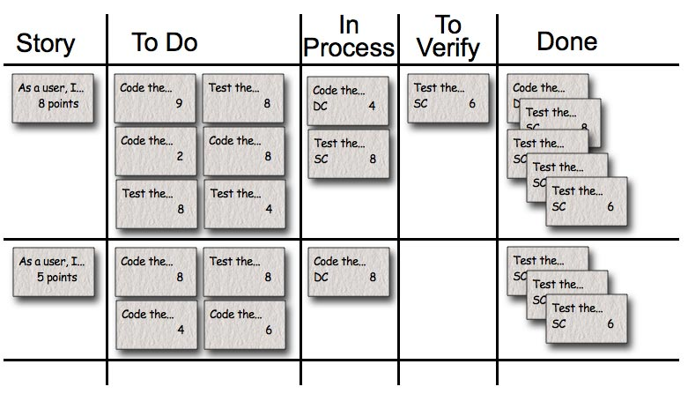
Daily Planning
Kanban Board on Daily basis

Slide 136
Agile Project Tracking

Slide 137
Kanban Board
After iteration planning is complete and before agile team starts working on task of the iteration, agile team need to pull the task from sprint backlog and put on kanban board
Kanban board has several columns. You can customize these columns based on your project characteristics. Typical columns are “User Story”, “To be done”, “Doing”, “Done”, ”Accepted”
You keep moving tasks from of any user story from left to right based on the progress. Finally when all the work is done all the cards will move under “Done” and user story will move user “Accepted” column

Slide 138
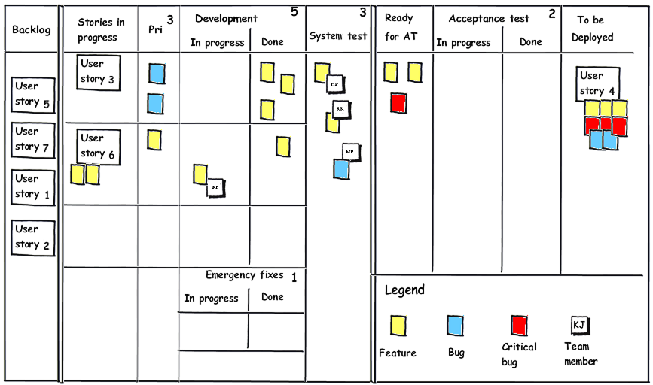
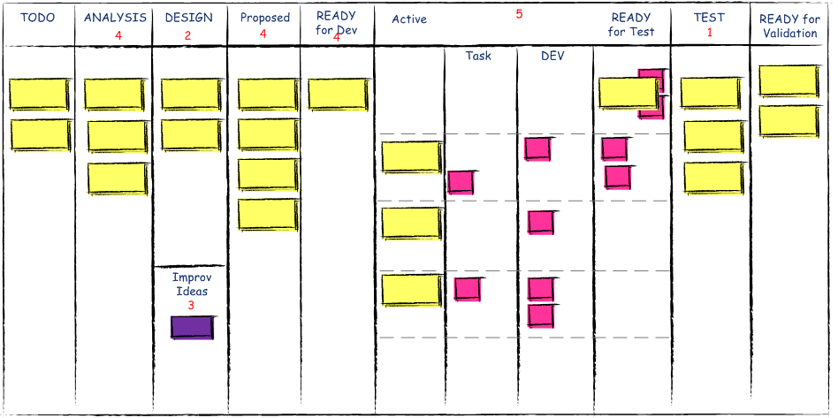
Kanban Board
Story Kanban Board
Tools & Techniques / Planning, Monitoring & Adapting/ Agile Project Tracking
Task Kanban Board

Slide 139
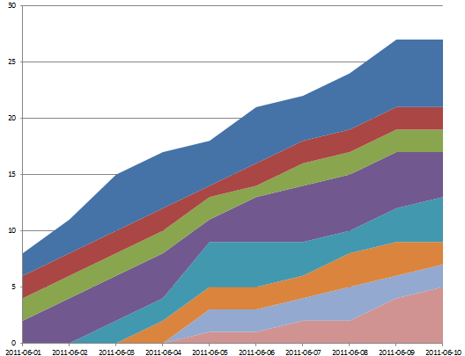
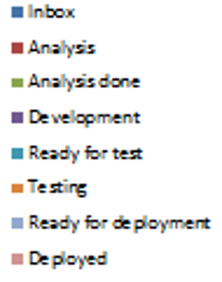
Cumulative Flow Diagram (CFD)

Slide 140
WIP Limit
WIP limit is maximum number of work in progress items
In Kanban concept agile team should ensure that during execution at no point of time items in “in-progress” column should cross a defined WIP limit
“In-progress” work is treated as of no-value thus it is treated as waste. Therefore to maximize the value focus should be to convert WIP items into completed
Just-in-time (JIT) concept should be utilized to keep WIP limit smallest possible
Low WIP limit is also a challenge as it creates wastage of machine and workforce time

Slide 141
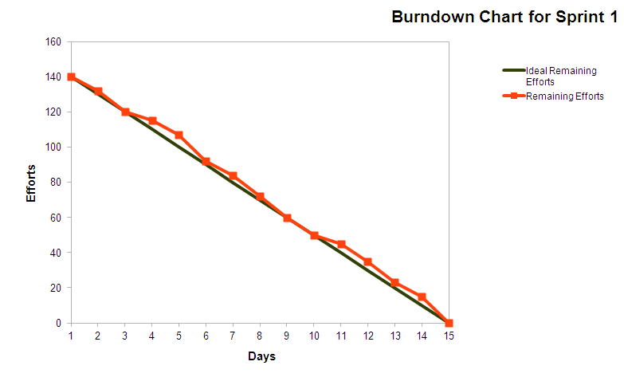
Burn Chart
Burn Down Chart

Slide 142
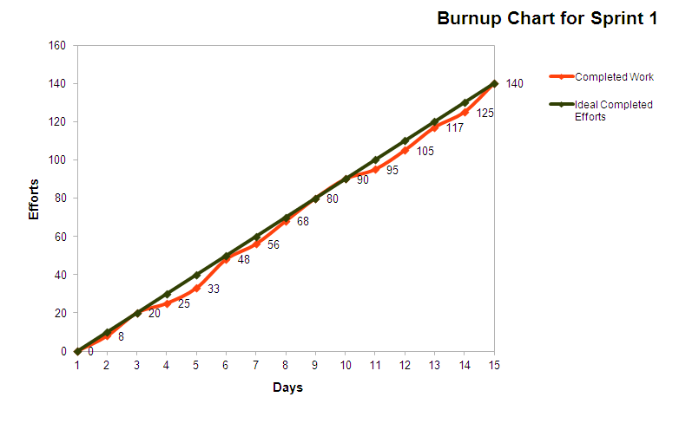
Burn Chart
Burn Up Chart

Slide 143
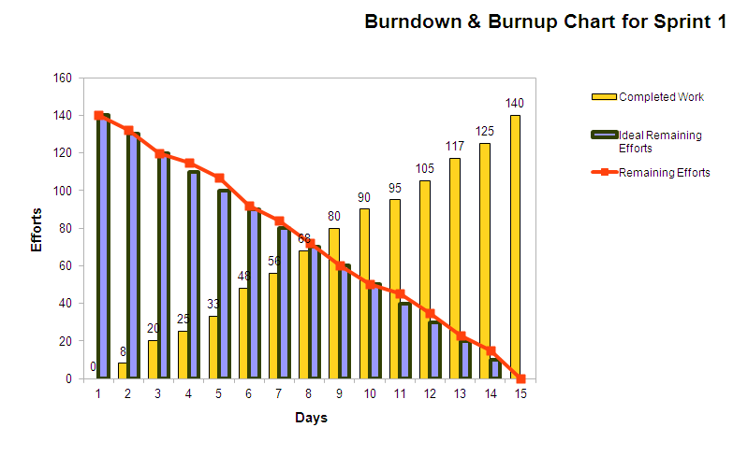
Burn chart
Burn-down & Burn-up combine chart

Slide 144
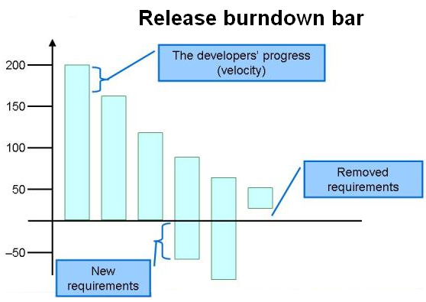
Burn Chart
Burn Down Bar Chart
User Stories
Iteration1
Iteration2
Iteration3
Iteration4
Iteration5
Iteration 6

Slide 145
Retrospectives
Retrospective is conducted by agile team at the end of each sprint and each release
Retrospective sessions are self-reflection sessions, to understand how we are doing and how can we improve it further. Kaizen is at the heart of every retrospective session.
Retrospective leads to adaptive planning
Depending upon the need, confidence of team, time of retrospective, nature of team members structure of retrospective can be adopted

Slide 146
Retrospectives
Structure of retrospective
Set the stage (set ground rule/ working agreement)
Gather Data (Share relevant data)
Generate Insights (ask why it happened and how it happened)
Decide what to do (Action plan)
Close Retrospective (Appreciate participation)

Slide 147
Retrospectives
Types of Retrospectives
Start, Stop, Continue : The facilitator captures team open-ended feedback using a wheel that encourages team members to assess an iteration or milestone. What should be start new, what should we stop, what should be continue from last iterations. Dur: 10 to 25
Force Field Analysis : A plan designed around the force field analysis technique. A retrospective for your whole company/department or to analyse a particular topic. Dur : 60
Pomodoro Retrospective : Focused and time-constrained by using the Pomodoro technique. Useful for determining a single action to improve the work of a small team. Dur : 25
Four L's Retrospective : Liked – Learned – Lacked – Longed For. Iteration and project retrospectives as well as for retrospection of training and conference events.. Dur : 90 - 120
Sailboat : What anchors slow the team down, what wind propels it forward?. Good for the "gather data" and "generate insights" portions of a retrospective. Dur : 90 - 120

Slide 148
Retrospectives
Temperature Reading
This retrospective can be conducted, to know the feeling, sentiments of the team. This is conducted by a facilitator and it follows following structure. Adequate time should be give to each part.
Specific Appreciation
New Information
Puzzles
Complaints with Recommendations
Goals, Hopes and Wishes

Slide 149
Retrospectives
ROTI (Return on Time Invested)
Feedback and Adaptation are part of Agile Project Management. Feedback starts with meeting and specifically retrospective meetings.
ROTI (Return on Time Investment) is a quick and easy method to gauge the time spent on meetings or workshops, and to improve their effectiveness.
Take 5-15 minutes at the end of the meeting to ask participants to rate their return on time invested, using the Fist of Five technique
If most of number you are getting is 1 or 2 then it means something is serious and you are wasting time and something different need to be done
ROTI is quick, easy, sometimes funny, and works very well, even with top management.

Slide 150
Agile Metrics
Notes:
150

Slide 151
Agile Project Metrics
Team Proactiveness
Team's ability to deliver the commitments
Team's ability to live agile values
Team's ability to agile principles
Helpfulness of team to each other
Ability to solve impediments
Customer Satisfaction Index
Functional Point Written by a team every month
Moral of the team every sprint
Trends of Impediments
Trends of Risk

Slide 152
Agile Project Metrics
Estimation accuracy curve
Commitment Curve
Velocity Curve
Issues in the issue log
Functional Point Test Coverage
Project Resource Iteration
Value Delivered Curve
Time spent on Rework Curve
Time spent on Technical Debt Curve
Number of Product Demos Curve
Team's unplanned leaves Curve
No of defect leak to production Curve
No of UAT test cases passed Curve
Test Coverage Curve

Slide 153
Metrics
Velocity
Velocity is number of story points a team can do in an iteration.
When you are starting a new project that point of time best way to know the productivity is guess based on previous experience. But never benchmark velocity of team based on previous project
It takes 3-4 iteration to stabilize velocity of a team
Methods to improve velocity
Periodically pay down technical debt
Improve customer involvement
Support energized work environment
Provide needed resources (people, equipment, software etc)
Offload admin duties of programmer
Add experienced programmers (at the start)
Do not add/remove resource in the team to influence velocity
If needed create a new team and put resources there to increase velocity
Notes:
153

Slide 154
Metrics
Escaped Defects
In Agile escaped defects mean those defects which are leaked to next iteration or sprint.
Escaped Defect Rate = Total number of weighted defects for a sprint / number of total stories delivered in that sprint
Tracking the trend of this metrics helps you understanding the quality of product and maturity of testing process
Cause of Escaped Defects may be
Over commitment and delivery & not negotiating
Adding more work without stabilizing the work already done
High Technical Debt
Notes:
154

Slide 155
Metrics
Lead Time : Time between a request being made and being fulfilled
Cycle Time : Time between start of work on a user story and making the feature available for delivery.

Slide 156
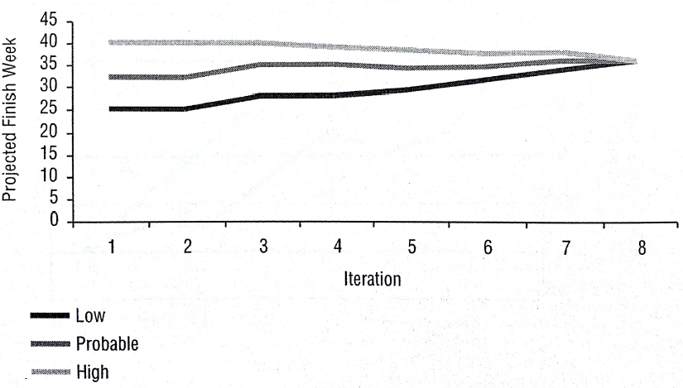
Metrics
Projected Scheduled
With x probability how much time is required to complete the project. Track this information for every iteration

Slide 157
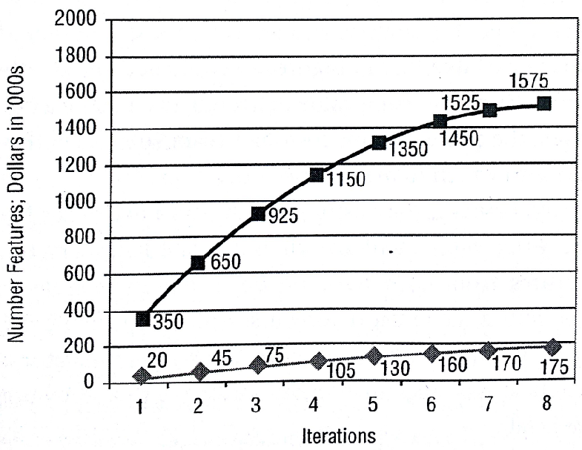
Metrics
Features & Value Delivered

Slide 158
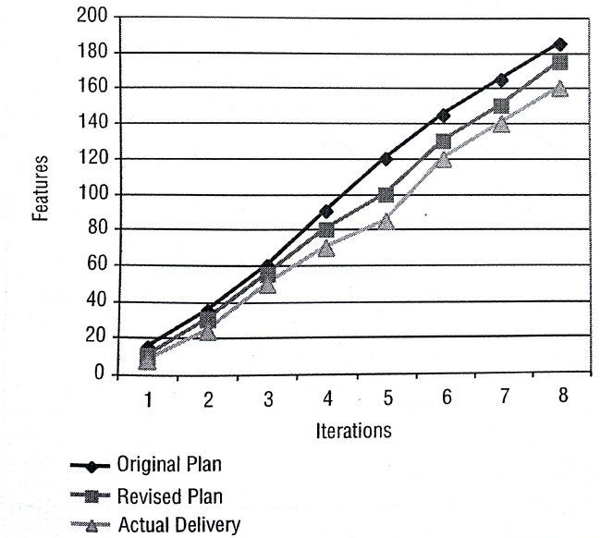
Metrics
Delivery Performance

Slide 159
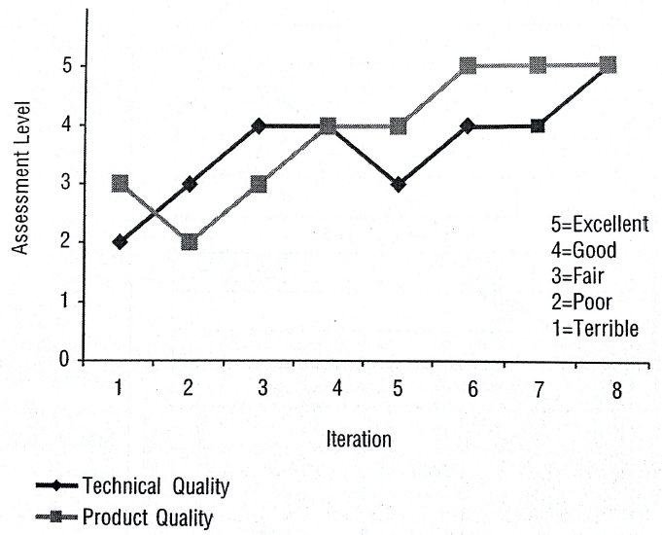
Metrics
Product and Technical Quality Assessment

Slide 160
Earn Value Management
CV = EV- AC
CPI = EV/ AC
SV = EV –PV
SPI = EV/PV
EV = BAC - ETC
EAC = AC + ETC
EAC = BAC / ETC
EAC = BAC / (SPI * CPI)
VAC = BAC –EAC
TCPI = (BAC-EV) / (EAC-AC)

Slide 161
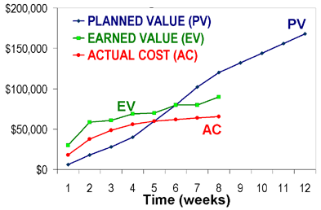
S Curve
Notes:
161

Slide 162
Tools & Techniques Product Quality
Notes:
162

Slide 163
Cost of Quality
Cost of conformance
Appraisal Costs
checking & Testing Purchased Goods
In-process and Final Inspection Testing
Field Testing
Product, Process and Service Audits
Calibration of Measuring and Test Equipment
Prevention Costs
Capability Evaluation
Error Proofing
Quality Planning
New Product Review
Quality Improvement Project
Quality Education and Training
Supplier Evaluation
Cost of nonconformance
Internal Failure Costs
Re-design
Downtime
Re-testing
Shortages
Delays
Rework
Lack of flexibility
External Failure Costs
Environmental Costs
Loss due to Sales Reductions
Warranties
Repairing Goods
Complaints

Slide 164
Definition of Done (DoD)
The DoD changes over time. Organizational support and the team’s ability to remove impediments may enable the inclusion of additional activities into the DoD for features or sprints.
Continuous Integration (CI) helps you validating the “Doneness”
There are 3 level of DoD
Story DoD
Iteration DoD
Release DoD

Slide 165
Definition of Done (DoD)
Story “Done”
Unit test should provide 60-70% test coverage
Story is either written in pair or reviewed by peer
All code checked in
All unit code passed
All acceptance test case passed
Story accepted by owner

Slide 166
Definition of Done (DoD)
Iteration “Done”
Iteration should have defined Iteration Goal
All acceptance test cases should run for all user stories in Iteration
All stories completed must be accepted by the product owner
Defects identified are fixed or planned for future
Code performance is tested and accepted
If database is involved then database script should be available, automated and tested
Backup of iteration work product is taken

Slide 167
Definition of Done (DoD)
Release “Done”
Release should have defined Release Goal
Product has formal release date
Product is deployed on staging area
Stress testing done and results accepted
All non-functional requirements are tested and results accepted
Required documentation is available
Release should not have any known bug

Slide 168
Feedback Techniques of Agile Project Management
Timely & regular feedback is heart beat for producing a good quality product and managing risks. Following techniques are used to get quick feedback.
Release planning
Sprint planning
Daily stand-up
Sprint review
Sprint retrospective
Pair programming
Peer review
Customer involvement throughout PLC

Slide 169
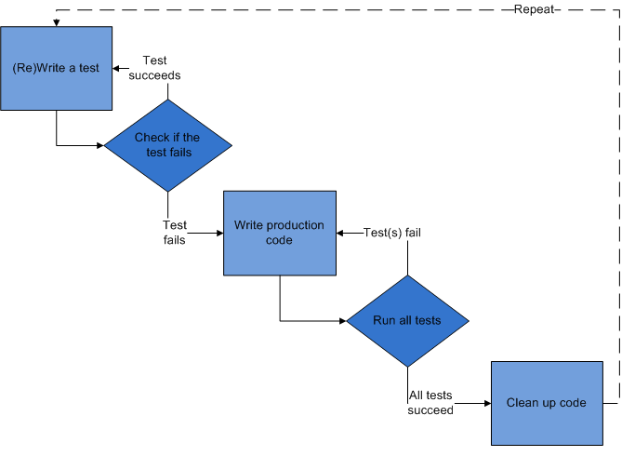
Test Driven Development (TDD)
Programmer should not consider exception cases and error handling initially. Those can be considered in next cycle, once basic functionality is working.
If built passes unit test then only it is promoted to the next step as a candidate for acceptance test build

Slide 170
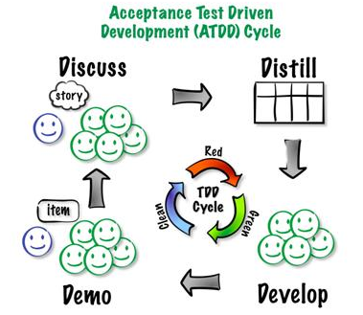
Acceptance Test Driven Development (ATDD)
Major difference between ATDD and TDD is in ATDD user story or functionality is tested not the task like in TDD.
Using ATDD practice you are not allowed to add more functionality until earlier user stories are successful.
Collection of acceptance test cases forms regression test and it should run automatically on built server

Slide 171
Exploratory Testing
After acceptance test cases are passed then Agile tester may choose to perform exploratory testing
In exploratory testing agile tester tests those scenario which system user is not supposed to perform but if he perform in that case system should give proper message.

Slide 172
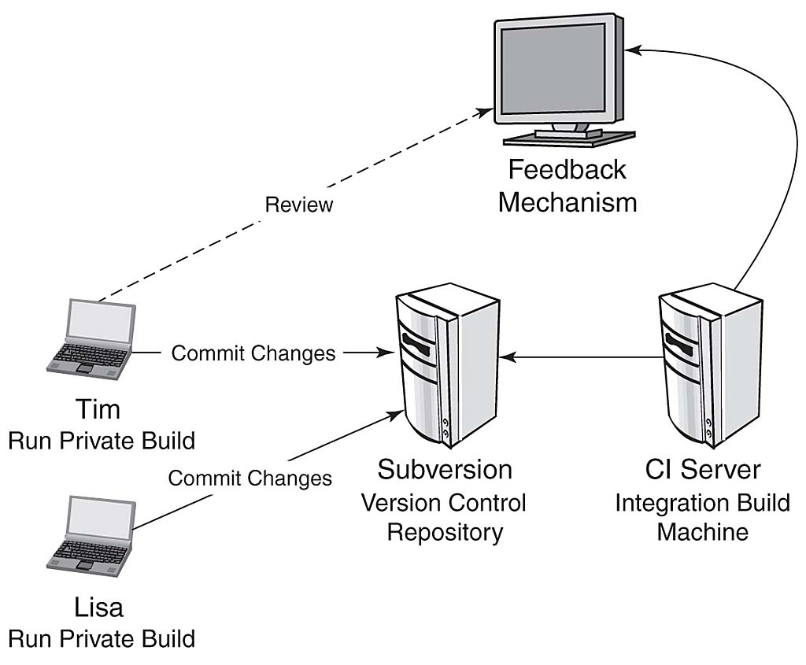
Continuous Integration
Tool: CruiseControl for Java & .NET
Build should happen within 10 min, else change server
No partial build
Email to Lisa if any of her code breaks

Slide 173
Continuous Process Improvement
Models for Continuous Process Improvement
PDCA Cycle (by Juran - “Fintness for Use”)
Score Card
Escaped defects, Overtime, Velocity, Cost, Time
Balance Score Card (BSC)
Four aspects of BSC are Financial, Customer, Internal Business Proceeds, Learning and Growth
Six Sigma (DMAIC)
Motorola in 1985
Used widely by Jack Welch @ GE in 1995
Kaizen
Eliminating the waste
Kanban

Slide 174
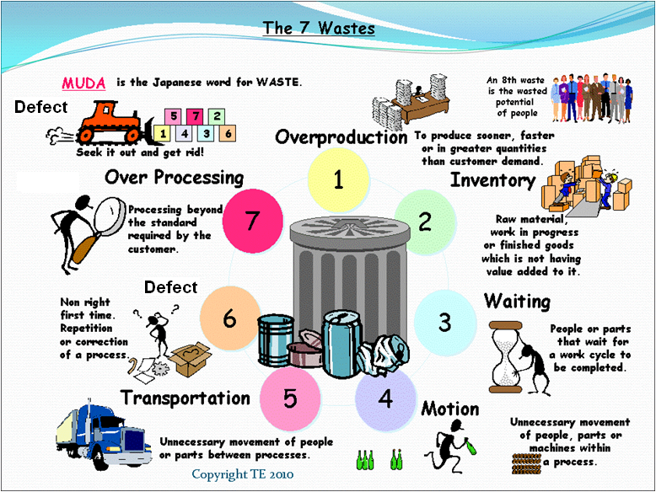
7 Wastes
TIM WOOD

Slide 175
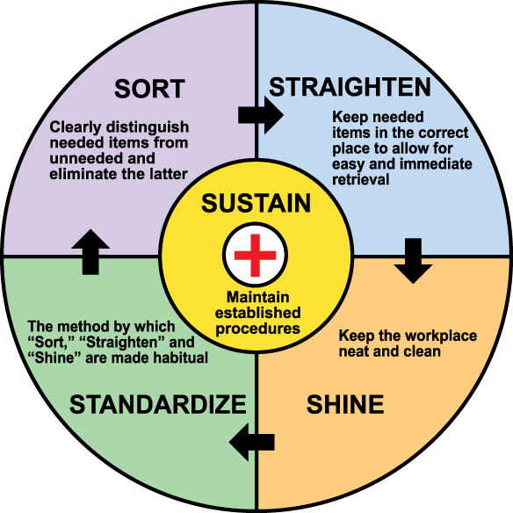
House Keeping Standard (5S)
In Lean 5S is foundation tool for continuous improvement.
5S is also called house keeping standard because it lists down the steps to organize a work space for efficiency and effectiveness by identifying and storing the items used, maintaining the area and items, and sustaining the new order.

Slide 176
Version Control
A version control system is a repository of files and source code, with monitored access. Every change made to the source is tracked, along with who made the change, why they made it, and references to problems fixed, or enhancements introduced, by the change. This is very important tool to ensure quality product.
Collective code ownership means whole team takes responsibility of the quality of the code therefore anybody can modify the code, if needed. (Encouraged in XP Agile Method)
Strong code ownership means each person owns his module. Only he can make changes to his module.
Weak Code Ownership means one person write the module but another person can make changes as long as owner helps them or they coordinate with owner
When two users can update the same code at same time is called Concurrent editing. Conflict is resolved using merging method.

Slide 177

Version Control
Don’t save change = Revert
Label “Release A”
Checkout File “ABC”
Save change to repository =
Checkin or Commit
Sandbox
Repository
Remove tip from the repository
= RollBack
ver 1
ver 2
File “ABC” is locked
It can be updated
Merge
Branch
ver 1
ver 2
Tip or Head

Slide 178
Agile Tooling Mistake
For producing a good quality product agile project management relies heavily on automation. Therefore not investing in tools or using legacy tools for agile project management affects the moral of the team and quality of the product
Generally following mistakes are made by organization in agile tooling
Using old version of tool which were working for waterfall
Not investing on automation tool still continuing manual testing, documentation etc
Working on age old slow hardware, while team is wasting time
Not investing time on continuous-integration tool
Using traditional waterfall metrics to manage the project
Performing continuous integration only on mainline not on branch so branch code becomes buggy and unreliable.

Slide 179
Typical Software Tools in Agile Projects
Agile project management systems (APMS) for effective communication and providing bird’s eye view of the project
Rally, VersionOne, Jira
Testing Tools to achieve 100% code coverage by auto unit testing.
xUnit
Regression Testing Tool
CruiseControl, TFS
Version Control to mange versions of code, product, test-case, tested product
SVN, SourceSafe, TFS

Slide 180
Tools & Techniques Soft Skills
Notes:
180

Slide 181
Shu-Ha-Ri
Shu-Ha-Ri is Japanese term according to this a student or team goes through three stages of learning. Whatever you teach them it takes time to master the art. Three stages are
Shu: This is the initial obedient stage, when the student just follows the rules.
Ha: The student questions the rules, understands their importance, and makes innovations within the rules.
Ri: The student breaks the rules and creates his own rules, thereby escalating to the master level.

Slide 182
Collaboration
Collaboration is animated two way conversation with real understanding and progress happening. Collaboration means whole is more than the sum.
Eight agile practices which helps team and stakeholders in effective collaboration are
Trust => to thrive on relations
Sitting together => for quick and accurate communication
Real customer involvement => to make sure that team understand what to build
A ubiquitous language => to help team members, customer understand each other
Stand up meeting => to keep team member informed
Coding standards => to seamless integrate the work of individual’s work
Iteration demos => to keep the team’s efforts aligned with stakeholder goals
Reports => to help reassure the organization that the team is doing well

Slide 183
Adaptive Leadership
Organization does not work in incubator but in volatile, fragile, competitive world. It is not possible to deliver results if we do not learn from mistakes, accommodate change request or changed condition. It is impossible to know everything before we start.
Adaptive leadership pays attention to value delivery, flexibility, fluidity, cooperation, reprioritization, simplicity, self-organizing, local decision making, innovation, lifelong learning, discuss diverse and divergent views.

Slide 184
Agile Team
Agile team is smaller compare to Waterfall team size
Scrum suggests team size of 7 ± 2. But maximum team size recommended in Agile is 20
If you need to add more resource than add more experienced people rather adding junior people
If you further need to add more team member then use agile scaling principle

Slide 185
Agile Team Scaling
Create feature team (vertical team) do not create skill wise (horizontally).
Create high level scrum of scrum teams
Everyday standup meeting is joined by one designated person from each team
Extra four questions for Scrum of Scrum Daily Standup meeting
What has your team done since we last met?
What will your team do before we meet again?
Is anything slowing your team down or getting in their way?
Are you about to put something in another team's way?

Slide 186
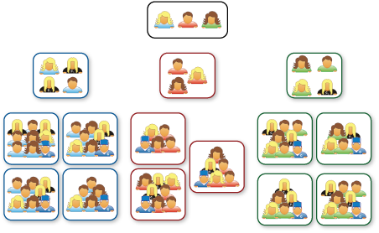
Agile Team Scaling

Slide 187
Type of Teams
 | Manager lead team | Self-managing team | Self-organizing team | Self-governing team
Setting overall direction for the team
Designing the team and its context
Managing work processes and monitoring progress
Executing the team task

Slide 188
Value Based Prioritization
Notes:
188

Slide 189
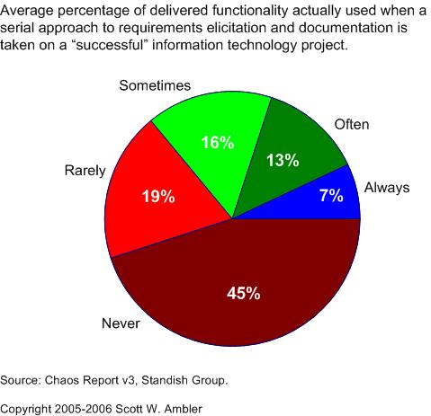
Value of Delivered and non-used Features
Tools & Techniques / Value Based Prioritization & Value Streaming

Slide 190
JIT in Value Delivery
Your customer asks you to develop an application with 50 features, out of these 10 are business critical. Application will be ready in 12 months. You are in 3rd week in the project and ask these questions to yourself
What is the value of detail plan of this whole application?
What is the value of hiring those resources/expertise which you need after 6 month (that too not sure)?
What is the value of detail design, SRS, Functional specification (especially when you know they are going to change)?
What is the value of writing test cases for complete application?
What is the value of hardware, software, infrastructure which you do not need today?
JIT (Just In Time) principle helps controlling our greed and maximizing value.
Companies like Toyota, Dell start using this concept early in the industry.

Slide 191
Sources of Revenue
Incremental Revenue
Comes from existing customer
New Revenue
Comes from new customer
Retained Revenue
Comes by enhancing the existing feature. But if you do not enhance features then customer will buy other product.
Operational Efficiency Revenue
Comes by improving operational process

Slide 192
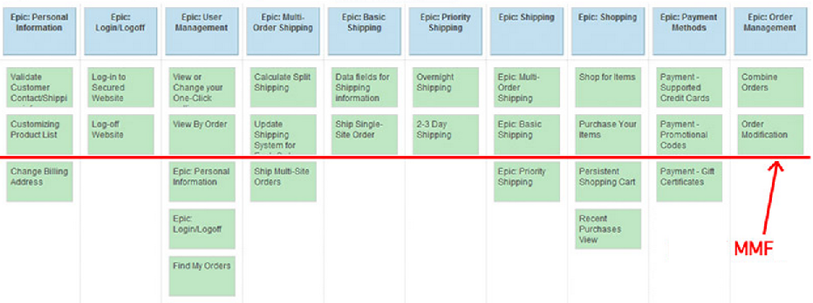
Minimum Marketable Features (MMF)
Product is saleable or usable or viable only when a set of minimum number of features is built there in the product. Generally all these features are part of a single release. This is called MMF.

Slide 193
Prioritization & Ranking Methods
Prioritization
Agile project management is based on principle of incremental delivery and deliver fast. Thus we must know the prioritization methods so that we can deliver high business values items earlier.
Possible Factors of prioritization are as below. Each factor may have different weightage (business value has highest weightage) when you prioritize your product backlog items.
Business Value
Cost of Implementation
Prioritization Scenario
Implementation Time
Frequency of usage
Safety
Implementation Difficulty
Stability
Re-usability
Dependency

Slide 194
Relative Prioritization & Ranking Methods
1 Customer Value Prioritization
Customer based on input from internal stakeholders assigns some priority to each requirement
2 Forced Ranking Techniques
Force customer to assign unique rank number to each requirement
Requirements | Stakeholder1 | Stakeholder2 | Stakheolder3 | Total | Ranking
Req#1 | 1 | 5 | 4 | 10 | 2
Req#2 | 2 | 4 | 5 | 11 | 1
Req#3 | 3 | 3 | 3 | 9 | 3
Req#4 | 4 | 1 | 2 | 7 | 5
Req#5 | 5 | 2 | 1 | 8 | 4
Highest score lowest Rank

Slide 195
Relative Prioritization & Ranking Methods
3 Analytical Hierarchical Process (AHP)
Relative prioritization comparing feature pair wise
4 Paired Comparison Techniques
Like AHP but priority can only 0 or 1
Requirements | Req#1 | Req#2 | Req#3 | Req#4 | Req#5 | Total | Ranking
Req#1 | 0 | 1 | 1 | 1 | 1 | 4 | 1
Req#2 | 0 | 0 | 1 | 1 | 1 | 3 | 2
Req#3 | 0 | 0 | 0 | 1 | 1 | 2 | 3
Req#4 | 0 | 0 | 0 | 0 | 1 | 1 | 4
Req#5 | 0 | 0 | 0 | 0 | 0 | 0 | 5
Highest score lowest Rank

Slide 196
Relative Prioritization & Ranking Methods
5 Weight-based Prioritization Techniques
Requirements | Raw Scoring | Scaled Scoring | Ranking
Req#1 | 4 | .22 | 2
Req#2 | 4 | .22 | 2
Req#3 | 5 | .27 | 1
Req#4 | 2 | .11 | 4
Req#5 | 3 | .16 | 3
 | 18
Highest score lowest Rank

Slide 197
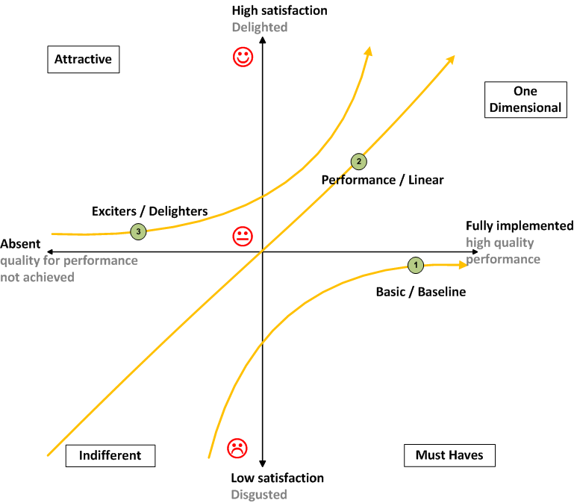
Relative Prioritization & Ranking Methods
6 Kano Analysis

Slide 198
Kano Analysis
Must-be: Leaking milk packet
One-dimensional: Milk packet says that it has 10% extra milk at the same price but actually it has 6% extra
Attractive: Name of farmer, village, cow breed on milk packet
Indifferent: Font size or color of the text on the milk packet
Reverse: Few people like milk in paper carton others in plastic packet or some others in boxes

Slide 199
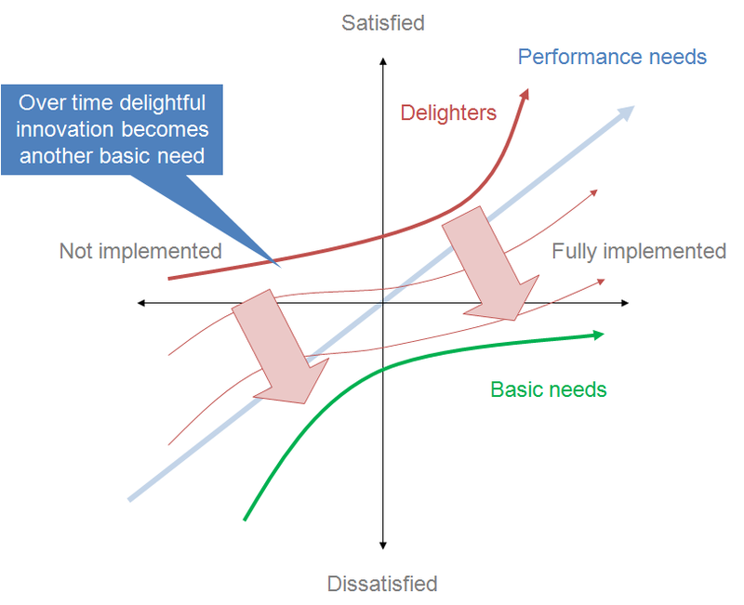
Kano Analysis

Slide 200
Relative Prioritization & Ranking Methods
100 Point Method
Each stakeholder is given 100 points and they can use these points to buy the requirements they want
Requirements | Stakeholder1 | Stakeholder2 | Stakheolder3 | Total | Ranking
Req#1 | 0 | 20 | 30 | 50 | 3
Req#2 | 30 | 10 | 40 | 80 | 2
Req#3 | 50 | 20 | 20 | 90 | 1
Req#4 | 20 |  | 10 | 30 | 4
Req#5 | 0 | 50 | 0 | 50 | 3

Slide 201
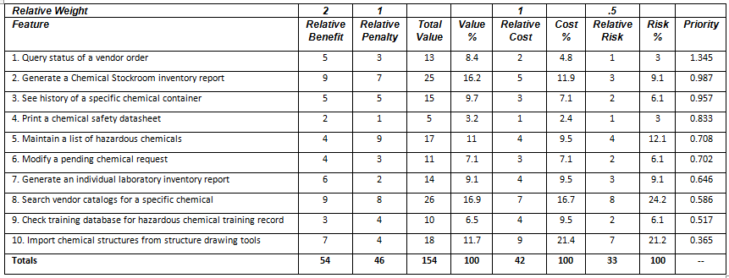
Multiple Parameter Based Prioritization
Done by Customer
Done by Developer
value percentage / (cost percentage * cost weight) + (Risk percentage * Risk weight)
Done by Customer
Potential negative impact of not doing the feature
Notes:
http://msdn.microsoft.com/en-us/library/hh765981.aspx

Slide 202
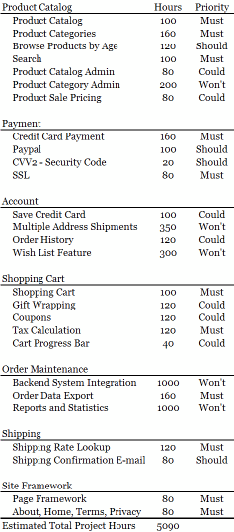
Multiple Parameter Based Prioritization
 | Hours | % of Total Hours
Must Have | 1200 | 56%
Should Have | 320 | 14%
Could Have | 660 | 29%
Tota Hours | 2240
Total Hours/Time box |  | 101%
Must have hours/Time Box |  | 57%
MoSCoW Prioritization
Mo = Must Have
S = Should Have
Co = Could Have
W = Wouldn’t have now
Notes:
http://www.websitehoncho.com/2011/10/moscow-prioritization-isnt-from-russia.html

Slide 203
Regulatory Compliance
Agile regulatory compliance are taken care by Agile PMO
Agile PMO conducts training for Agile Teams and ensure that they implement agile project management principles and the same time comply regulatory requirements
Example of regulatory compliance
CMMI
ISO
Sarbanes Oxley
Basel II
HIPAA
ISO 27001

Slide 204
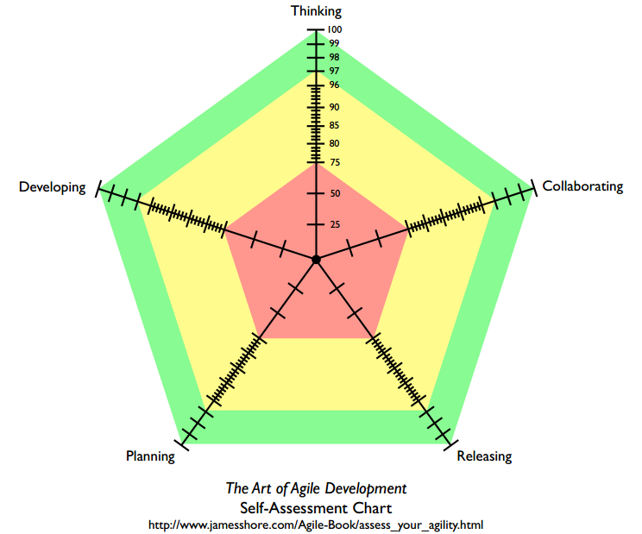
Agile Self-Assessment Chart

Slide 205
Agile Project Risk Management
Notes:
205

Slide 206
What is Risk?
Risk Responses: Threats & Opportunities
Risk is an event which has probability of happening in future and it can have negative or positive impact on the objective of the project
Risk itself is not negative or positive. Risk is perceived as negative or positive based on its impact on the project’s objectives.

Slide 207
Risk Attitude
Risk Seeker
They look for opportunities to get more return
Risk Neutral
They do not look for opportunity but if something comes on the way and they are getting corresponding returns for this then they take risk
Risk Averse
They are very conscious about the risk and they do not want to take risk.

Slide 208
Risk Management Terminologies
Assumptions, Dependencies, Constraints are root cause of risk
Sources of risks : Depending upon business domain of the project its sources may be technology, skills, resource availability, project management practices etc.
Proximity of risk : In future how soon risk is going to occur
Risk Area: What are geographies, department, components, services, server etc. will be affected by the risk
Risk Urgency : If it occurs how soon it will impact the project objective: immediately, in short run, in long run

Slide 209
Plan Risk Management
Setup Risk Management Framework
Identify tools & templates
Conduct awareness training for risk management activities
Establish responsibilities for Risk Management Activities
Establish risk reporting formats and frequency
Determine who will conduct risk audit and when
Define risk attitude and risk appetite of key stakeholders

Slide 210

Project Risk Profile

Slide 211

Risk Adjusted Backlog
Risk Score

Slide 212

Risk Burn-down Graph
Risk Responses: Threats & Opportunities
Actual Risk Trend line
Ideal Risk Trend line
If actual risk trend line is above than ideal trend line then it means risks are not coming down at the appropriate rate

Slide 213
Identify Risks
Risk Responses: Threats & Opportunities
Risk identification is performed for each product backlog items
Every team member is responsible for identifying risk and updating related data/graph
Risk Identification techniques
Brainstorming Technique
Delphi Technique
Checklist Analysis

Slide 214

Probability and Impact Matrix
Risk Responses: Threats & Opportunities
Which risk you would chose to respond or which you can afford to accept depends upon your risk appetite. Your risk appetite for each risk depends upon the exposure of the risk under consideration.

Slide 215
Qualitative Risk Analysis
Risk Responses: Threats & Opportunities
Agile project management prefers Qualitative Risk Analysis method for analysis and prioritization of the risk
This is the quick and simplest way of risk analysis
In this method you need to determine probability and impact. Exposure can be calculated by multiplying probability and impact. This step is called probability and impact assessment.
Rank risks based on their exposure and pick up those top risks which you cannot afford to forego
Even if you have 50 risks in your risk register do not choose to work upon more than 10 on any point of time.

Slide 216
Risk Categorization
Risk Responses: Threats & Opportunities
Risk can categorized based on
Ranking of risk
Cause of risk
Response type
Priority of risk
Any other specific trend

Slide 217
Addressing an Unknown
In the product backlog sometimes agile team may find some epic/feature/user story which they are not able to understand. Therefore it is difficult to estimate those epic/features/ stories. Keeping the stories in the product backlog as estimated and in priority order is essential, as it gives the product owner insight into approximately which features will be completed by a certain date. There are 2 ways of solving this problem
Spike Solution
Tracer Bullet Solution

Slide 218
Addressing an Unknown
A Spike Solution
Spikes allows a team to set some amount of time to research and explore some unknown factor about an upcoming story.
Create an experimental solution that cuts through all the “layer”. The code is thrown away once solution is verified. No time is estimated for this kind of solutions but typically 1-2 days time is allowed to create a spike solution. Spike solution can be developed using A technology and actual implementation can be done using B technology.
Tracer Bullet
Create an experimental solution that cuts through all the “layer”. The code is not thrown away once solution is verified but it is extended. This is not time-boxed solution and final implementation should be in the same language in which tracer bullet solution was developed.

Slide 219
Risk-based Spikes
Risk Responses: Threats & Opportunities
Spike is a technical investigation to research an answer to a problem
Unlike Technical spike risk-based spikes gets the answer through analysis. Technical spike depends upon technical research and feasibility study.
Using Risk-based spikes there are four ways to know the answer of any complex problem
Sensitivity Analysis
Decision Tree Analysis
Expected Monetary Value (EVM) Analysis
Simulation

Slide 220
A Glance on Risk Response Plan
Risk Responses: Threats & Opportunities
Threats or Negative Risk | Opportunities or Positive Risk
Avoid | Exploit
Transfer | Share
Mitigate | Enhance
Accept | Accept

Slide 221
Monitoring & Controlling Risk
Risk Responses: Threats & Opportunities
Tools and techniques to monitor and control risks
Risk Audit
Secondary Risk
Residual Risk
Workarounds
Reserve Analysis

Slide 222
Understanding Reserves
Contingency reserves : Known – Unknown
It is designed for use only if certain events occur or only under certain predefined conditions, provided there is sufficient warning to implement the response.
Examples of events that may trigger the contingency response include missing intermediate milestones or gaining higher priority with a supplier.
Events triggering the contingency response should be triggered and tracked.
Management reserves: Unknown – Unknown
It is defined for use only if ‘the events that occur or only under certain conditions’, where information about the event & its occurrence is absolutely NOT available.

Slide 223
Scrum Methodology

Slide 224
Video: Basics of Scrum
S:\15-Video\B02-Agile-PM\Scrum 101 - Part 1 _ Scrum Basics

Slide 225
Scrum Roles
Product Owner
Scrum Master
Development Team

Slide 226
Video: Scrum Roles
S:\15-Video\B02-Agile-PM
Scrum Master Role with Jeff Sutherland

Slide 227

Scrum Values

Slide 228
Scrum Values & Typical Misunderstanding
Focus: Focusing on keeping the customer happy
Openness: Telling everyone everything about all your work
Respect: Thinking you are helping the team by being a hero. Or if I tell other person that this will not work then he will get hurt so better be silent.
Courage: Even after the decision has been made continuing to push back

Slide 229
Scrum Ceremonies
Daily Standup
Sprint Planning
Sprint Review
Sprint Retrospective
Product Backlog Grooming

Slide 230
Videos: Scrum Master Attitude
S:\15-Video\B01-For-Agile-Class\ I want to run an agile project

Slide 231
Videos: Daily Meetings
S:\15-Video\B02-Agile-PM
The Daily Standup
How to improve your Daily Scrum_

Slide 232
Video: Sprint Planning
S:\15-Video\B02-Agile-PM\How to improve your Scrum Sprint Planning

Slide 233
Video: Product BL Grooming
S:\15-Video\B02-Agile-PM\How to improve Scrum Backlog Refinement

Slide 234
Video: Sprint Reviews
S:\15-Video\B02-Agile-PM\How to improve your Scrum Sprint Reviews

Slide 235
Video: Sprint Retrospective
S:\15-Video\B02-Agile-PM\How to improve your Scrum Sprint Retrospective

Slide 236
Scrum Artifacts
User Story
Product Backlog
Sprint Backlog
Burndown/up/Velocity Chart

Slide 237
Agile anti-patterns or Agile Smells
Lack of overall product design
Adding stories to an iteration in progress
Lack of sponsor support
Insufficient training
Product owner role is not properly filled
Teams are not focused
Excessive preparation/planning
Problem-solving in the daily standup
Assigning tasks
Scrum master as a contributor
Lack of test automation
Allowing technical debt to build up
Attempting to take on too much in an iteration
Fixed time, resources, scope, and quality

Slide 238
Large-scale, offshore and distributed
Scaled Agile Framework (SAFe), Dean Leffingwell inter alia
Disciplined agile delivery (DAD), Scott Ambler inter alia
Large-scale scrum (LeSS), Craig Larman and Bas Vodde
Nexus (scaled professional Scrum), Ken Schwaber
Scrum at Scale, Jeff Sutherland, Alex Brown
Enterprise Scrum, Mike Beedle
Setchu (Scrum-based lightweight framework), Michael Ebbage
Xscale
Agile path
Holistic Software Development
Notes:
https://en.wikipedia.org/wiki/Agile_software_development

Slide 239
How to Avoid Fail in Agile?
Scrum master should have authority to resolve all impediments else complex dependencies would kill the project.
Periodically spend time on refactoring else there would be high risk of sustainability, maintainability and extensibility of the product.
Strike a balance using level of plan. Must have an overall plan.
Do not negotiate on quality and time. Do not force team to include more requirements else agile team will collapse quickly.
Product's success depends upon authority, knowledge and engagement of product owner. Chose a right person else team can be driven in the wrong direction.
Balance the documentation otherwise transfer of technology to new team members would be challenging.

Slide 240






hari.prasad@vedavit-ps.com
+91 9535999336
http://rarementors.com
https://in.linkedin.com/in/harithapliyal
@harithapliyal
http://pmlogy.com

Slide 241

Hari P Thapliyal,
PMP, PMI-ACP, MCITP, Princ2 Practitioner, CSM, MBA, MCA, CIC, PGDFM
PMO Architect & Project Management Evangelist
Profile: http://in.linkedin.com/in/harithapliyal
For content related queries please contact me via hari.Prasad@vedavit-ps.com
This document is proprietary and confidential. It remains the property of Vedavit Project Solutions at all times. No part of this document may be used, reproduced, or transmitted in any form or by any means electronic, including photocopying and recording, for any purpose without express consent of Vedavit Project Solutions.

